Slide 1
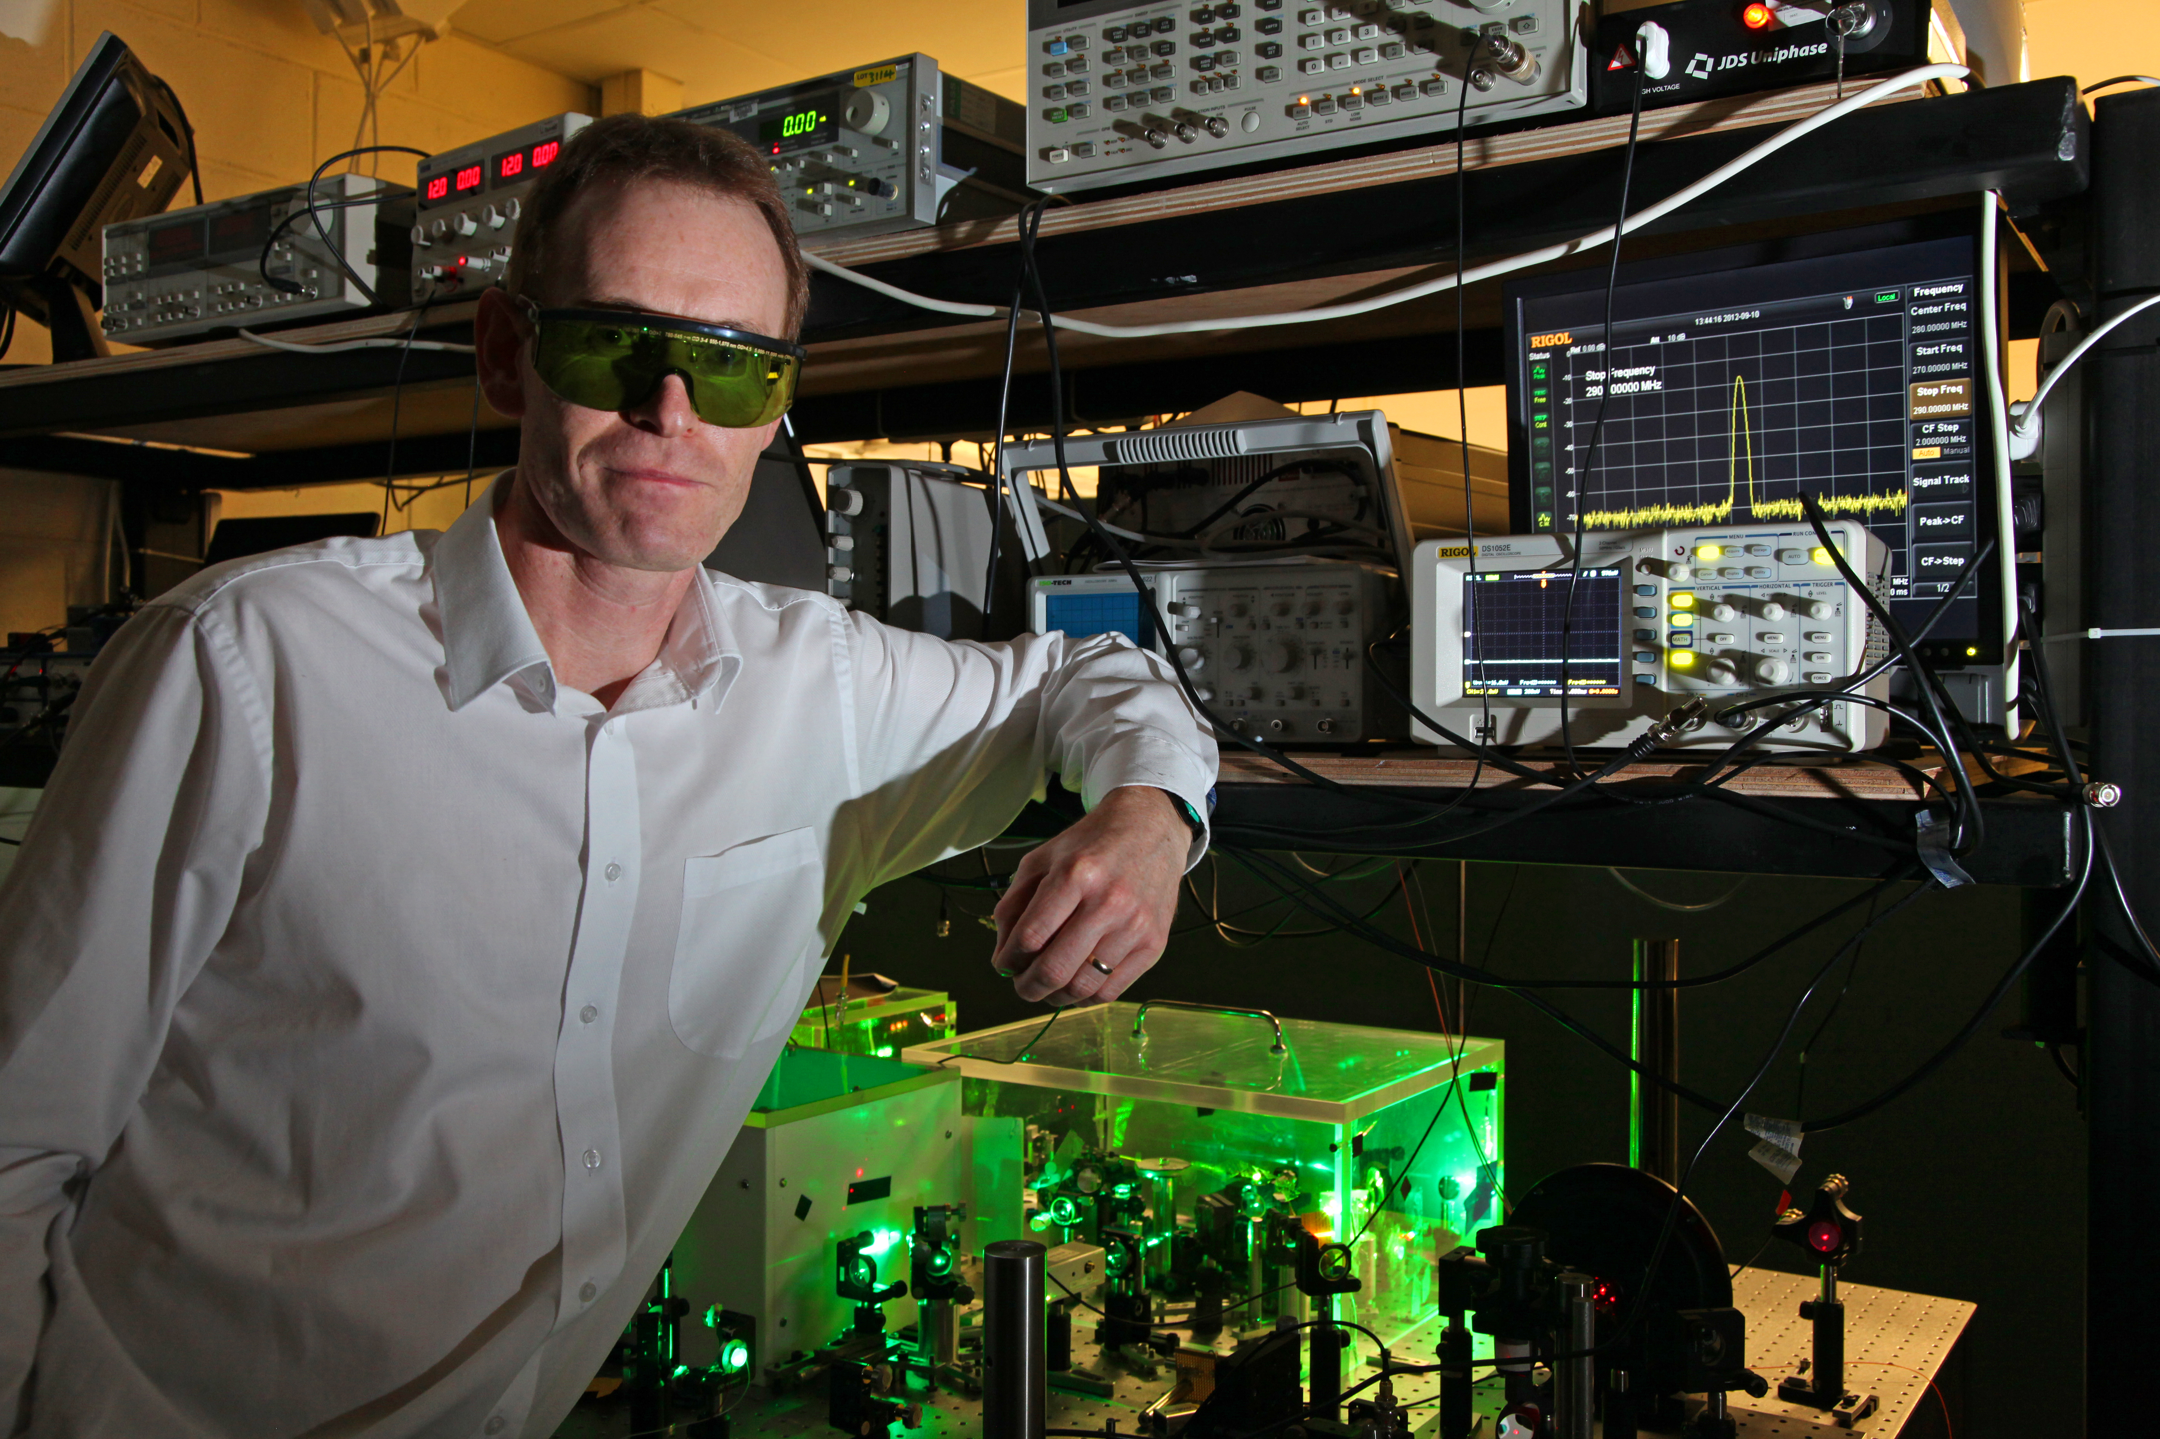
Infrared Optical Parametric Oscillator
Frequency Combs
Prof. Derryck Reid
Institute of Photonics and Quantum Sciences
Heriot-Watt University
Notes:
Heriot Watt has been active in frequency comb research since 2004. We have built a large number of modelocked Ti:sapphire lasers that provided fully-locked combs up to repetition frequencies of 500 MHz. Specifically, we developed a full comb on a single breadboard in 2011 (photo) as a demonstrator for M Squared Lasers, who subsequently licensed the technology from us. This is potentially important in as much as our contribution of comb technology to the ELT project could be supported by M Squared Lasers as potential manufacturing partner.
We have published a number of papers with NPL. In collaboration with Patrick Gill’s group we developed a robust new method for comb stabilisation, which provided a factor of 10 reduction in phase noise compared to the state of the art nonlinear interferometer. The figure below (left) shows graphically the noise improvement we achieved.
In the bottom right figure we show the radio frequency spectrum from our 500-MHz laser, and a zoomed in spectrum of the locked comb offset frequency of 10 MHz. Since 2004 we have increasingly developed more of our own locking electronics, so we have a large amount of control and flexibility in the locking circuits we use.

Slide 2
Outline
Motivation – HIRES calibration requirements
Introduction to OPO frequency comb technology
Concepts and operating principles
Comb-offset control in a fs OPO
Comb stability characterisations
250-MHz OPO comb
333-MHz OPO comb
Harmonically-pumped 1-GHz OPO comb
Fundamentally-pumped 1-GHz OPO comb
Towards multi-GHz OPO combs
FP-filtering to 10-GHz
Progress towards 10-GHz OPO combs
Notes:
Heriot Watt has been active in frequency comb research since 2004. We have built a large number of modelocked Ti:sapphire lasers that provided fully-locked combs up to repetition frequencies of 500 MHz. Specifically, we developed a full comb on a single breadboard in 2011 (photo) as a demonstrator for M Squared Lasers, who subsequently licensed the technology from us. This is potentially important in as much as our contribution of comb technology to the ELT project could be supported by M Squared Lasers as potential manufacturing partner.
We have published a number of papers with NPL. In collaboration with Patrick Gill’s group we developed a robust new method for comb stabilisation, which provided a factor of 10 reduction in phase noise compared to the state of the art nonlinear interferometer. The figure below (left) shows graphically the noise improvement we achieved.
In the bottom right figure we show the radio frequency spectrum from our 500-MHz laser, and a zoomed in spectrum of the locked comb offset frequency of 10 MHz. Since 2004 we have increasingly developed more of our own locking electronics, so we have a large amount of control and flexibility in the locking circuits we use.

Slide 3
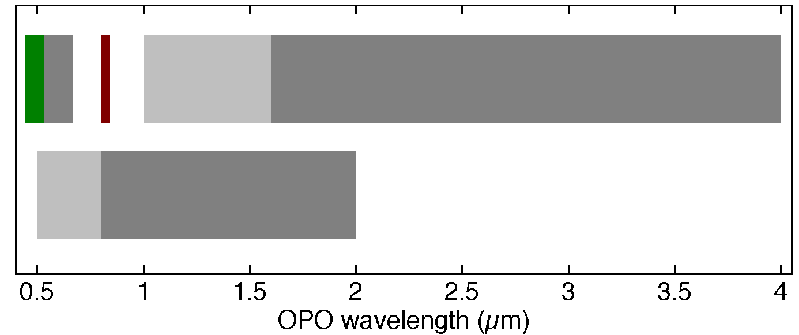
Motivation – HIRES calibration requirements
Wavelength tuning capability of a Ti:sapphire-pumped OPO, compared with:
ESPRESSO (Blue arm: 380 – 520 nm; Red arm: 520 – 780 nm)
HIRES (0.37 μm to 2.5 μm)
pump, signal & idler SFM
signal
idler
ESPRESSO
E-ELT HIRES
signal & idler SHG
0.5 1 1.5 2 2.5 3 3.5 4
OPO wavelength (µm)
This wavelength coverage is extremely challenging for laser frequency combs
⇒ motivates development of suitable OPO combs
Notes:
Core expertise in our group is the frequency conversion of modelocked lasers using optical parametric oscillators (“OPOs”) which allow a near-IR laser to be converted into the mid-IR, or (via frequency doubling) into tunable visible light. In 2007 our group was the first to extend the femtosecond frequency comb concept to OPOs, building a comb that spanned 400nm – 2400nm.
Since then we have refined the concept, paying particular attention to understanding the stability available from such OPO combs. We showed that a pump laser with no full comb stabilisation could be used to create a fully stabilized OPO comb, then we measured a stability of around 100 Hz in the optical comb line at 1.5 µm. The linewidth of the individual comb lines is very narrow, since the OPO has no gain storage. The image on the right shows a measurement of a 15-Hz linewidth.
Our current direction of travel is to increase the intermode spacing using Fabry Perot filter cavities, and also to investigate direct routes to higher repetition rates by using direct optical frequency referencig, e.g. to a hyperfine transisition in Rb vapour.
The requirements for the ELT are for comb spacings from 6 GHz (mid-IR) to 30+GHz (uv/visible). We can envisage a combination of OPO and laser routes to address these requirements. Mode flattening filters or even line-by-line shaping should be possible at these repetition rates.

Slide 4
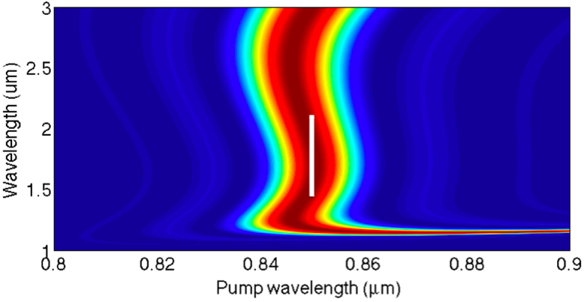

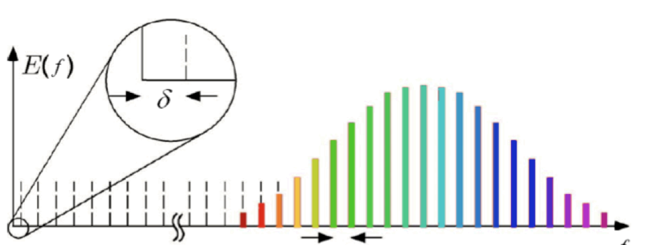
Motivation – HIRES calibration requirements
Aim to develop novel broadband OPO laser frequency combs for astronomy, such as radial-velocity extrasolar-planet surveys
Core concept is a broadband + tunable OPO
OPO = optical parametric oscillator
Tunability of a Ti:sapphire pumped PPKTP OPO
femtosecond pump laser
pump
signal
idler
λ
n = "mode order"
f
Notes:
Core expertise in our group is the frequency conversion of modelocked lasers using optical parametric oscillators (“OPOs”) which allow a near-IR laser to be converted into the mid-IR, or (via frequency doubling) into tunable visible light. In 2007 our group was the first to extend the femtosecond frequency comb concept to OPOs, building a comb that spanned 400nm – 2400nm.
Since then we have refined the concept, paying particular attention to understanding the stability available from such OPO combs. We showed that a pump laser with no full comb stabilisation could be used to create a fully stabilized OPO comb, then we measured a stability of around 100 Hz in the optical comb line at 1.5 µm. The linewidth of the individual comb lines is very narrow, since the OPO has no gain storage. The image on the right shows a measurement of a 15-Hz linewidth.
Our current direction of travel is to increase the intermode spacing using Fabry Perot filter cavities, and also to investigate direct routes to higher repetition rates by using direct optical frequency referencig, e.g. to a hyperfine transisition in Rb vapour.
The requirements for the ELT are for comb spacings from 6 GHz (mid-IR) to 30+GHz (uv/visible). We can envisage a combination of OPO and laser routes to address these requirements. Mode flattening filters or even line-by-line shaping should be possible at these repetition rates.

Slide 5
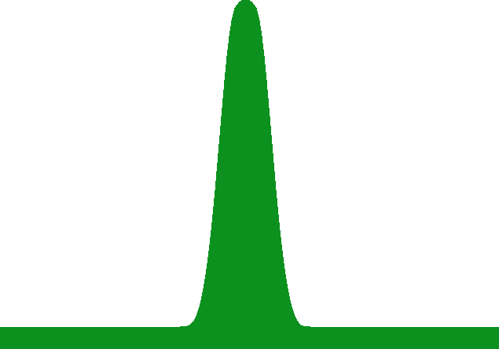
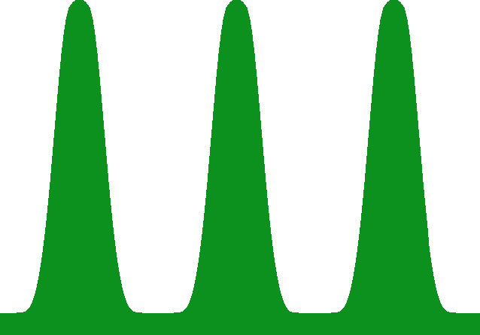
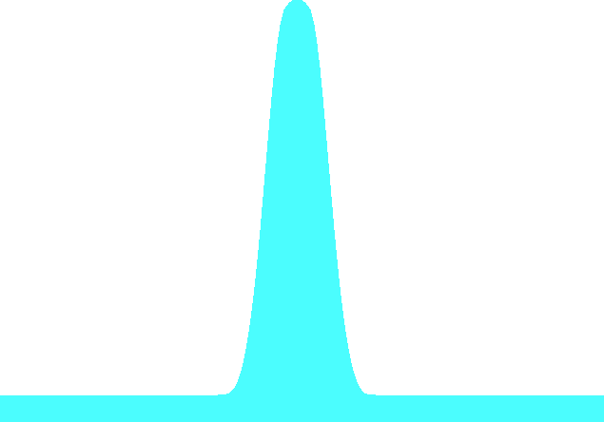
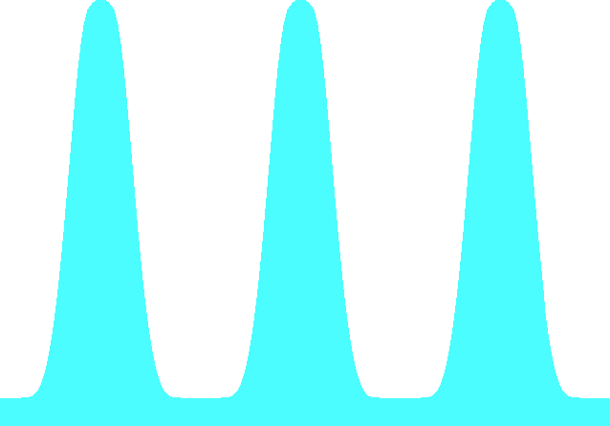
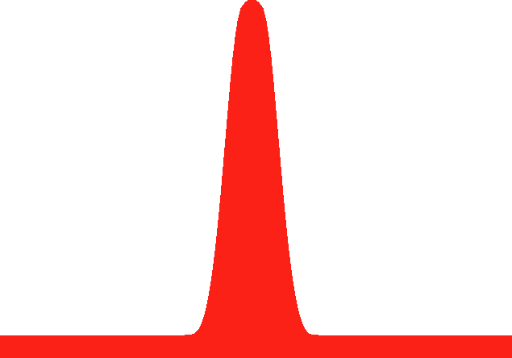
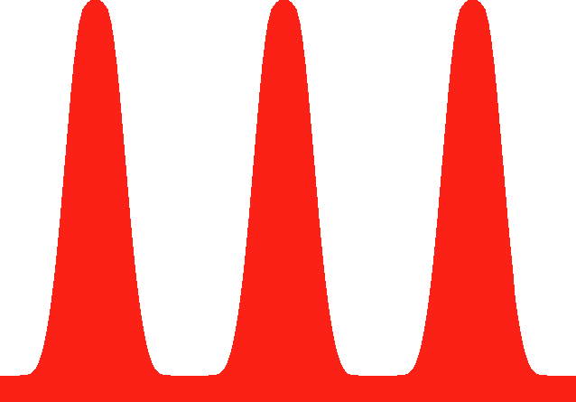

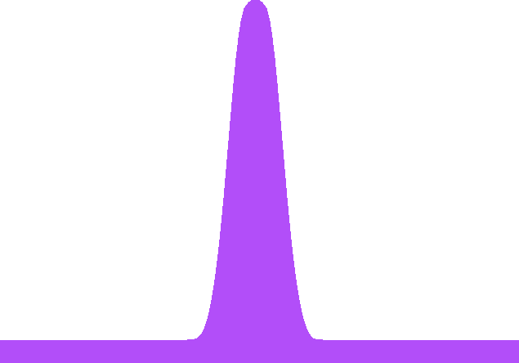
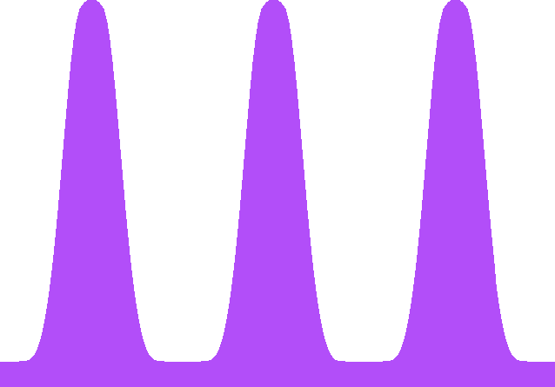
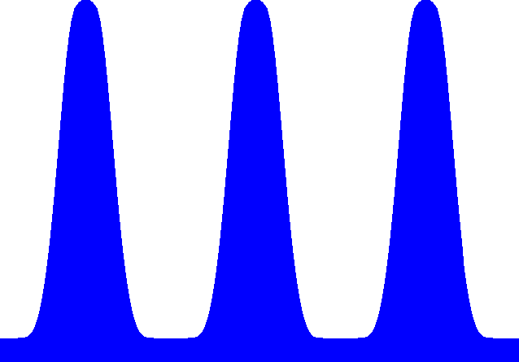
OPO comb concepts
1-GHz Ti:sapphire laser
SHG
SFM
Singly-resonant 1-GHz optical parametric oscillator frequency comb
OPO
f-to-2f
reference
Heterodyne locking
1-GHz Ti:sapphire laser
SHG
SFM
Doubly-resonant 1-GHz optical parametric oscillator frequency comb
OPO
f-to-2f
reference
Dither locking + heterodyne test
Doubly-resonant 10-GHz optical parametric oscillator frequency comb
10-GHz Ti:sapphire laser
SHG
SFM
OPO
Rb-ECDL reference
Dither locking

Slide 6
Operating Principles
An optical parametric oscillator is effectively a "photon splitter"
Every converted pump photon ( ), yields signal ( ) and idler ( ) photons
femtosecond laser
femtosecond OPO
Wavelength coverage from the visible to the mid-infrared is readily available by adjusting:
crystal phasematching (in practice, crystal position)
OPO cavity length (tens of µm adjustment)
Notes:
Heriot Watt has been active in frequency comb research since 2004. We have built a large number of modelocked Ti:sapphire lasers that provided fully-locked combs up to repetition frequencies of 500 MHz. Specifically, we developed a full comb on a single breadboard in 2011 (photo) as a demonstrator for M Squared Lasers, who subsequently licensed the technology from us. This is potentially important in as much as our contribution of comb technology to the ELT project could be supported by M Squared Lasers as potential manufacturing partner.
We have published a number of papers with NPL. In collaboration with Patrick Gill’s group we developed a robust new method for comb stabilisation, which provided a factor of 10 reduction in phase noise compared to the state of the art nonlinear interferometer. The figure below (left) shows graphically the noise improvement we achieved.
In the bottom right figure we show the radio frequency spectrum from our 500-MHz laser, and a zoomed in spectrum of the locked comb offset frequency of 10 MHz. Since 2004 we have increasingly developed more of our own locking electronics, so we have a large amount of control and flexibility in the locking circuits we use.

Slide 7

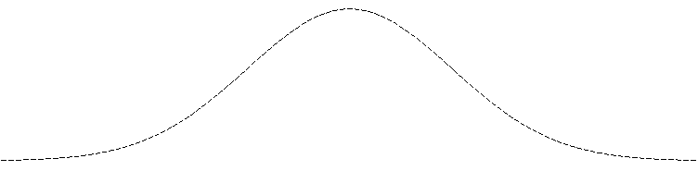

Comb-offset control in a fs OPO
Synchronously pumped OPOs have near-IR and mid-IR frequency combs with spacing equal to the pump.
Offsets of pump, signal and idler combs described by:
Femtosecond laser
OPO comb offsets are easily tuned by small (nm) changes to the cavity length
Power
idler (i)
signal (s)
pump (p)
f
Notes:
Heriot Watt has been active in frequency comb research since 2004. We have built a large number of modelocked Ti:sapphire lasers that provided fully-locked combs up to repetition frequencies of 500 MHz. Specifically, we developed a full comb on a single breadboard in 2011 (photo) as a demonstrator for M Squared Lasers, who subsequently licensed the technology from us. This is potentially important in as much as our contribution of comb technology to the ELT project could be supported by M Squared Lasers as potential manufacturing partner.
We have published a number of papers with NPL. In collaboration with Patrick Gill’s group we developed a robust new method for comb stabilisation, which provided a factor of 10 reduction in phase noise compared to the state of the art nonlinear interferometer. The figure below (left) shows graphically the noise improvement we achieved.
In the bottom right figure we show the radio frequency spectrum from our 500-MHz laser, and a zoomed in spectrum of the locked comb offset frequency of 10 MHz. Since 2004 we have increasingly developed more of our own locking electronics, so we have a large amount of control and flexibility in the locking circuits we use.

Slide 8
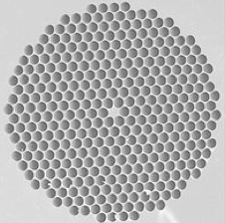
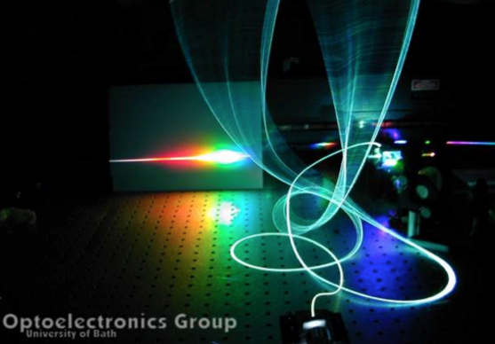
Principle of detecting the OPO comb offset frequency
The carrier envelope offset can be measured by using interference between the pump super-continuum and the pump + signal, or pump + idler sum-frequency mixing light e.g. idler CEO:
idler (i)
signal (s)
pump (p)
f
sum-frequency-mixing (SFM)
pump super-continuum (s/c)
The beat signal between f_{S/C} and f_{SFM} contains the frequency δ_{i}, and harmonics of the laser repetition frequency, F_{rep}.

Slide 9
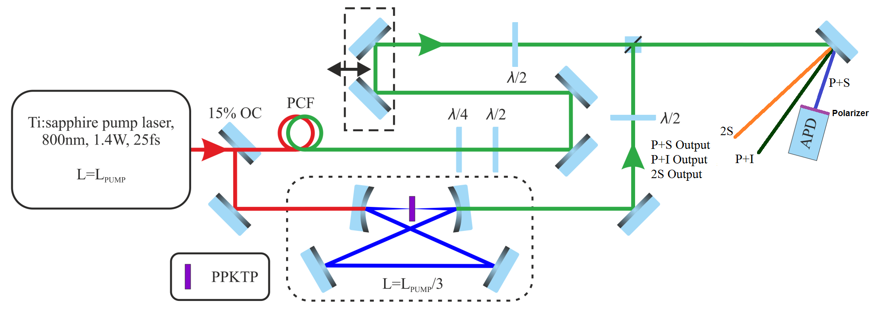
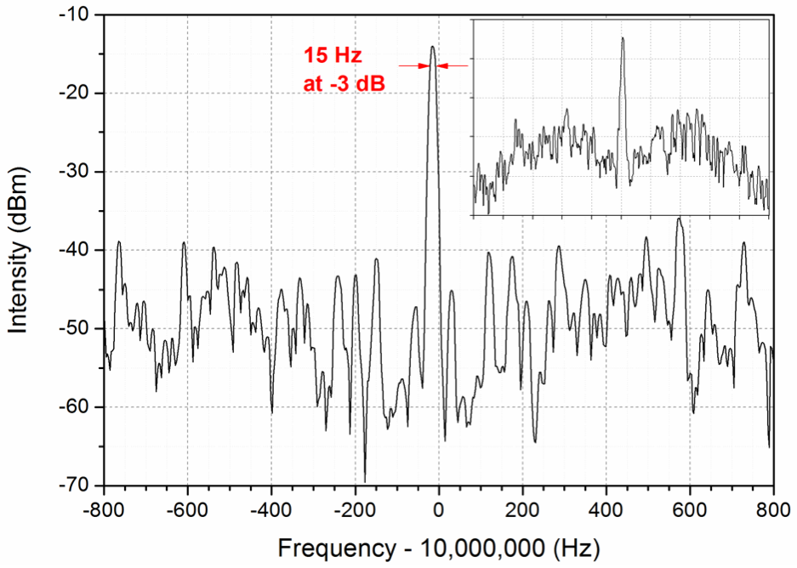
Experimental detection of the OPO comb-offset signal
δ_{s} locked to 10 MHz with -3-dB linewidth of 15 Hz
Comparable to nominal 10-Hz resolution of the RF spectrum analyzer
Far lower than linewidths of competitive combs:
Cr:forsterite, 1 MHzª
Er:fibre, 600 kHz^{b}
ª Tillman et al, Appl. Opt. 48, 6980 (2009)
^{b} Lim et al, Opt. Express 17, 14115 (2009)

Slide 10
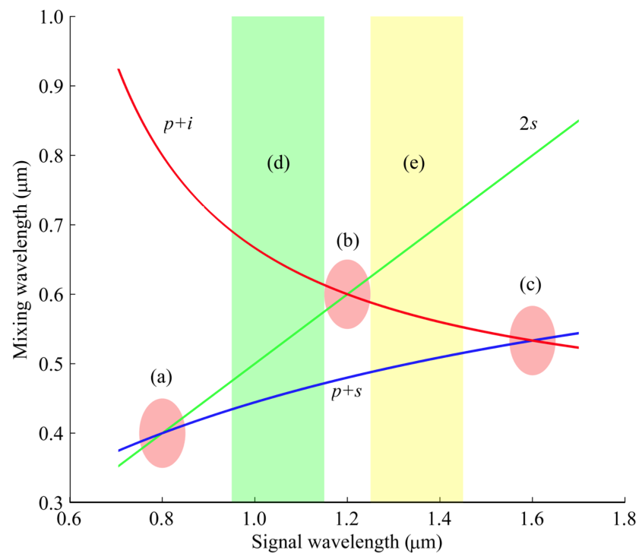
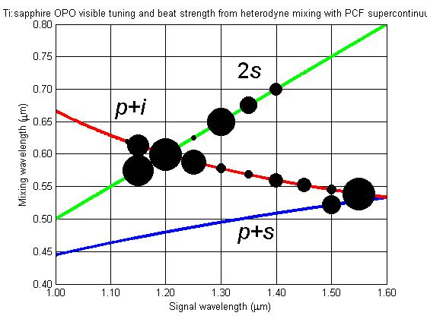
What limits the operating wavelengths of an OPO comb?
Heterodyne either p+s, 2s or p+i OPO outputs with pump super-continuum
SFM / SHG outputs for a Ti:sapphire-pumped OPO
p_{S/C}
2s
p+i
p+s
degeneracy
heterodyne together
Heterodyne p_{S/C} : p+i to control the i comb (OPO piezo actuator) ⇒ f_{CEO} = f_{REF}
Heterodyne p_{S/C} : 2s to control the p-2s comb ⇒ f_{CEO} = f_{REF}
Heterodyne p_{S/C} : p+s to control the s comb ⇒ f_{CEO} = f_{REF}
^{i}
^{p-2s}
^{s}

Slide 11

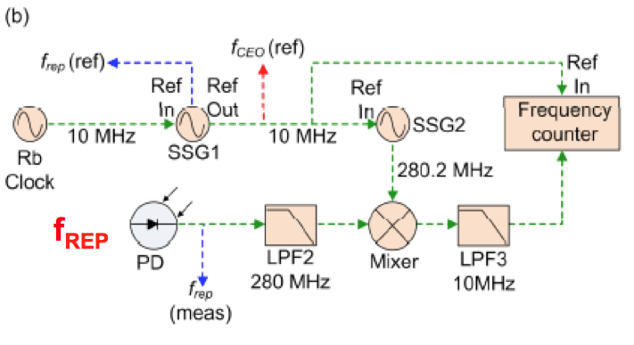
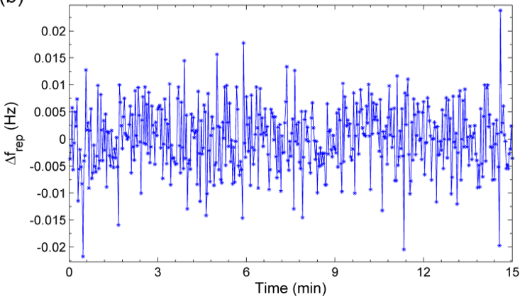
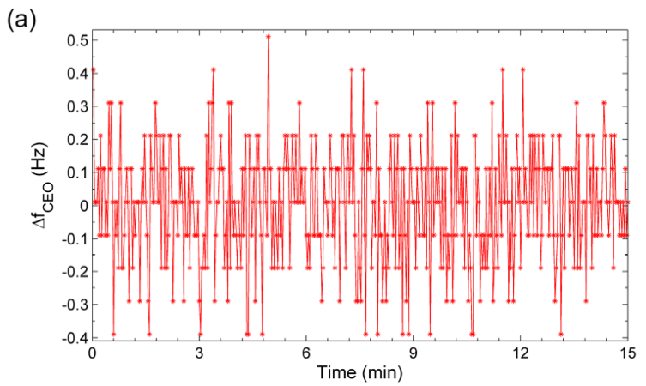
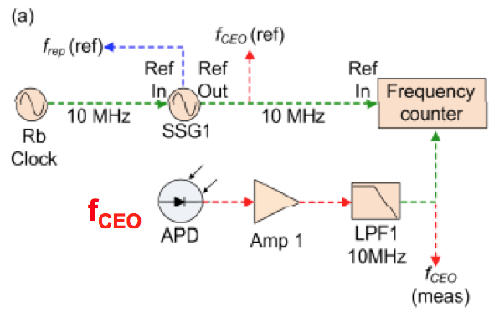
Comb stability characterisations: 250-MHz OPO
Teresa I. Ferreiro, Jinghua Sun, and Derryck T. Reid, Opt. Express 19, 24159 (2011)
How accurately can the positions of the modes in an OPO comb be controlled?
f_{REP}
f_{CEO}
The frequency of the n^{th} mode f_{n} determined by 2 parameters:
• sub-mHz stability (~10⁻¹³), but uncertainty in f_{n} multiplied by n ~ 10⁶
• δ sub-Hz level stability (~10⁻¹⁰), contributing only additively to f_{n} uncertainty
⇒ uncertainty in the repetition-rate dominates by factor of ~1000 !

Slide 12
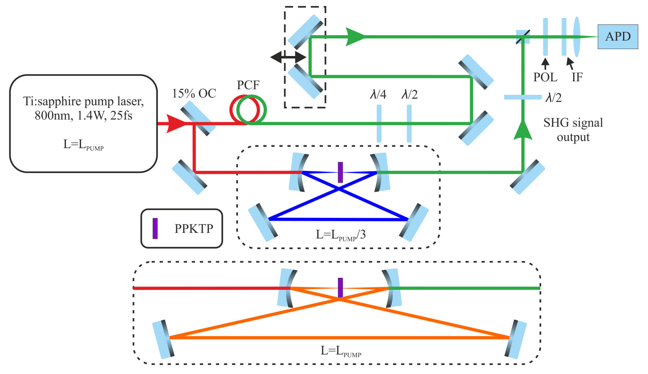


Comb stability characterisations: 333-MHz & 1-GHz OPOs
K. Balskus, R. A. McCracken, Z. Zhang and D. T. Reid submitted for publication
Harmonic pumping, where the OPO cavity is made n times shorter than the pump laser multiplies the repetition frequency by n
Performance compared of 333-MHz and 1-GHz OPO combs, pumped by a 333-MHz Ti:sapphire laser
333 MHz
1.4 W
25 fs

Slide 13
Comb stability characterisations: 333-MHz & 1-GHz OPOs
K. Balskus, R. A. McCracken, Z. Zhang and D. T. Reid submitted for publication
Harmonic pumping, where the OPO cavity is made n times shorter than the pump laser multiplies the repetition frequency by n
Performance compared of 333-MHz and 1-GHz OPO combs, pumped by a 333-MHz Ti:sapphire laser
333 MHz
1.4 W
25 fs

Slide 14
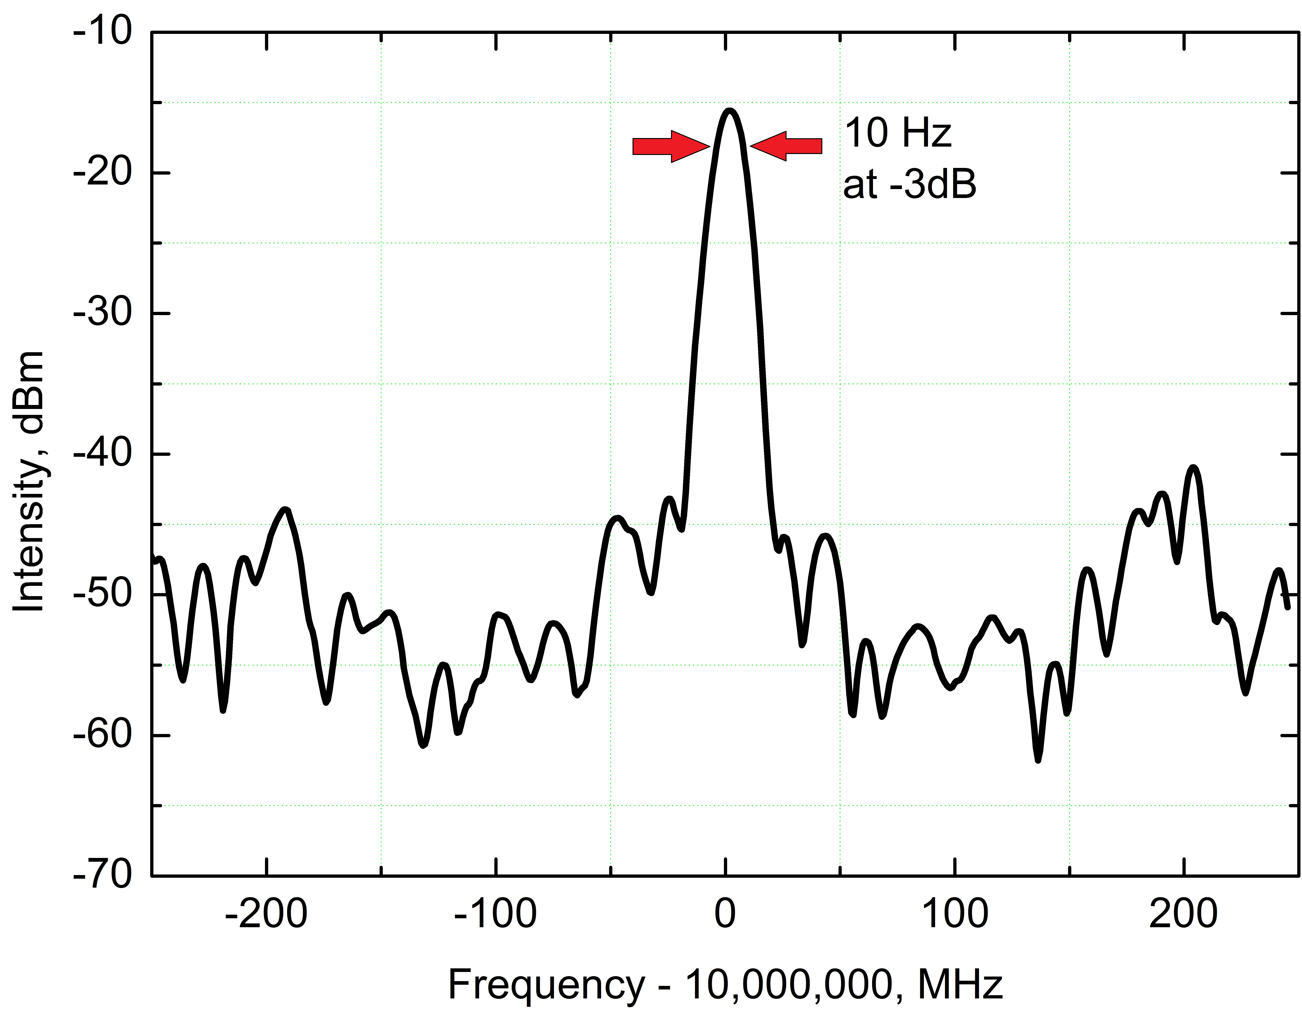
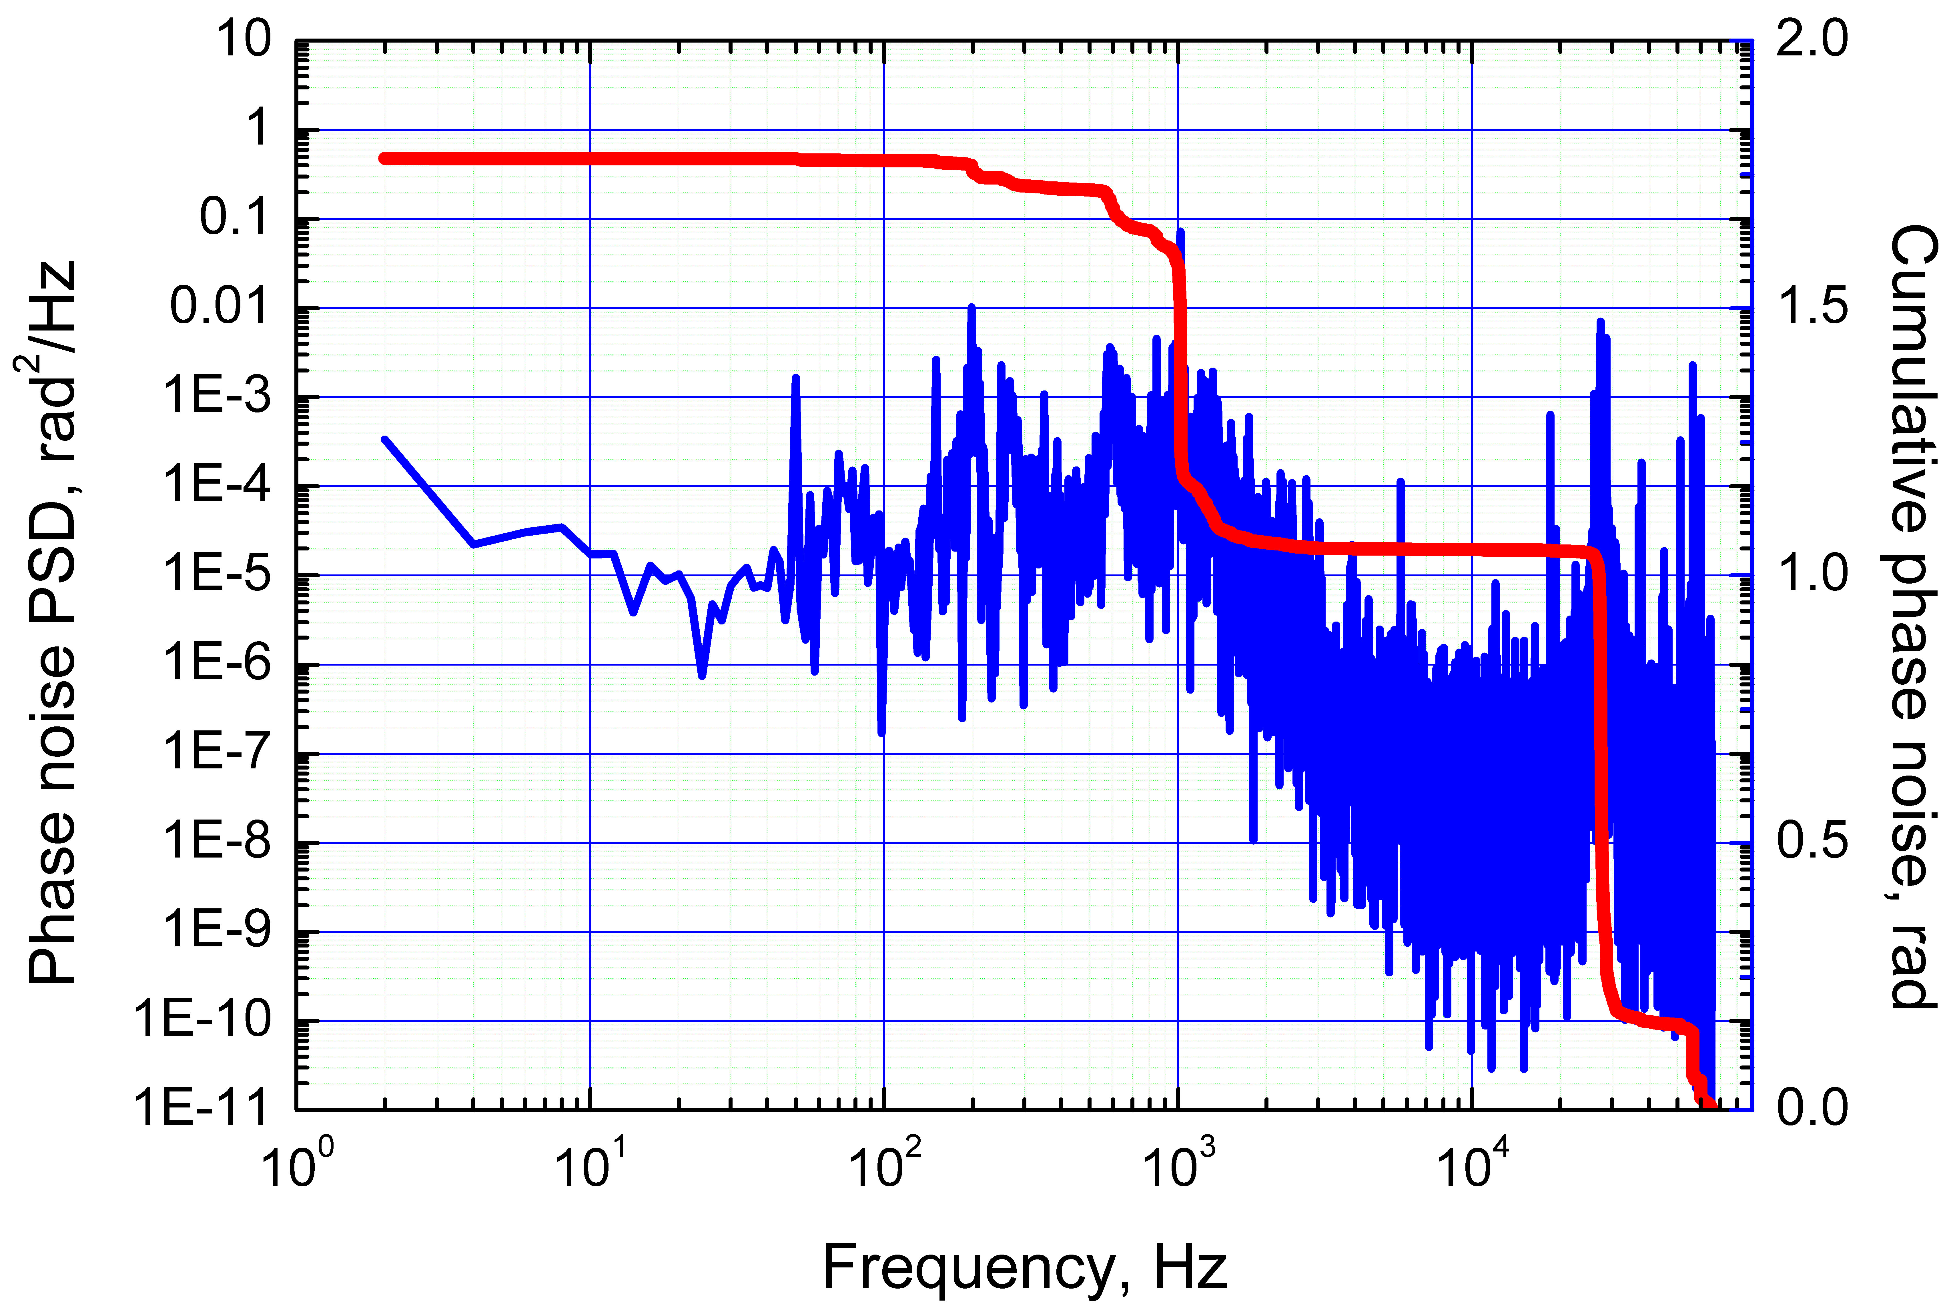
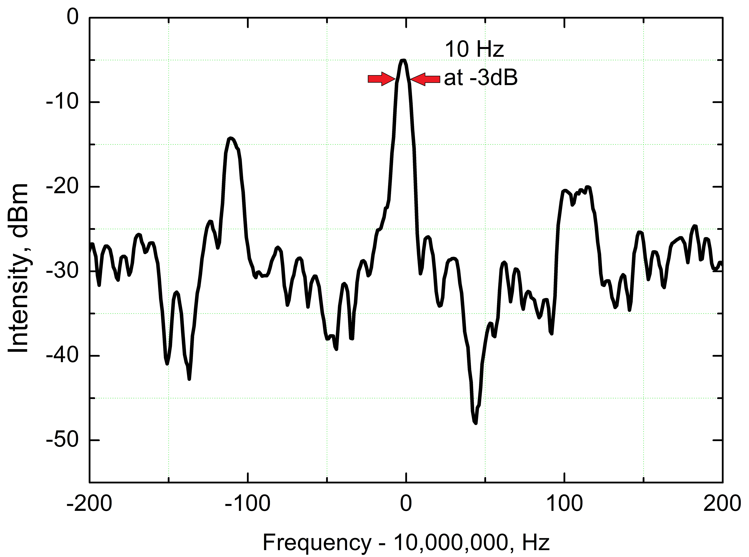
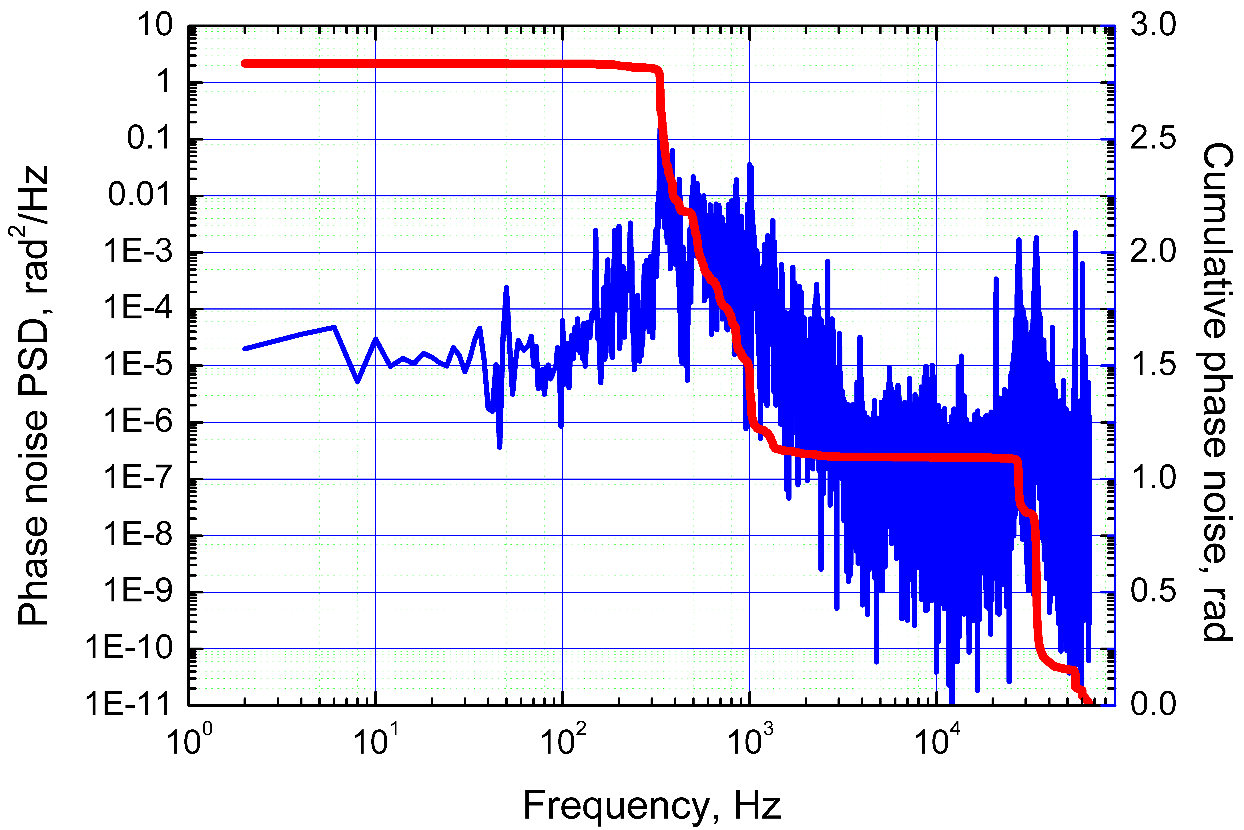
Comb stability characterisations: 333-MHz & 1-GHz OPOs
K. Balskus, R. A. McCracken, Z. Zhang and D. T. Reid submitted for publication
Comb offset, δ, locked to 10 MHz and measured with 10-Hz resolution bandwidth
Phase-noise power spectral density from 1 Hz – 100 kHz
10 Hz @ -3 dB
1.8 rad
2.8 rad
333 MHz
1 GHz
27-kHz RIN from pump laser
10 Hz @ -3 dB

Slide 15
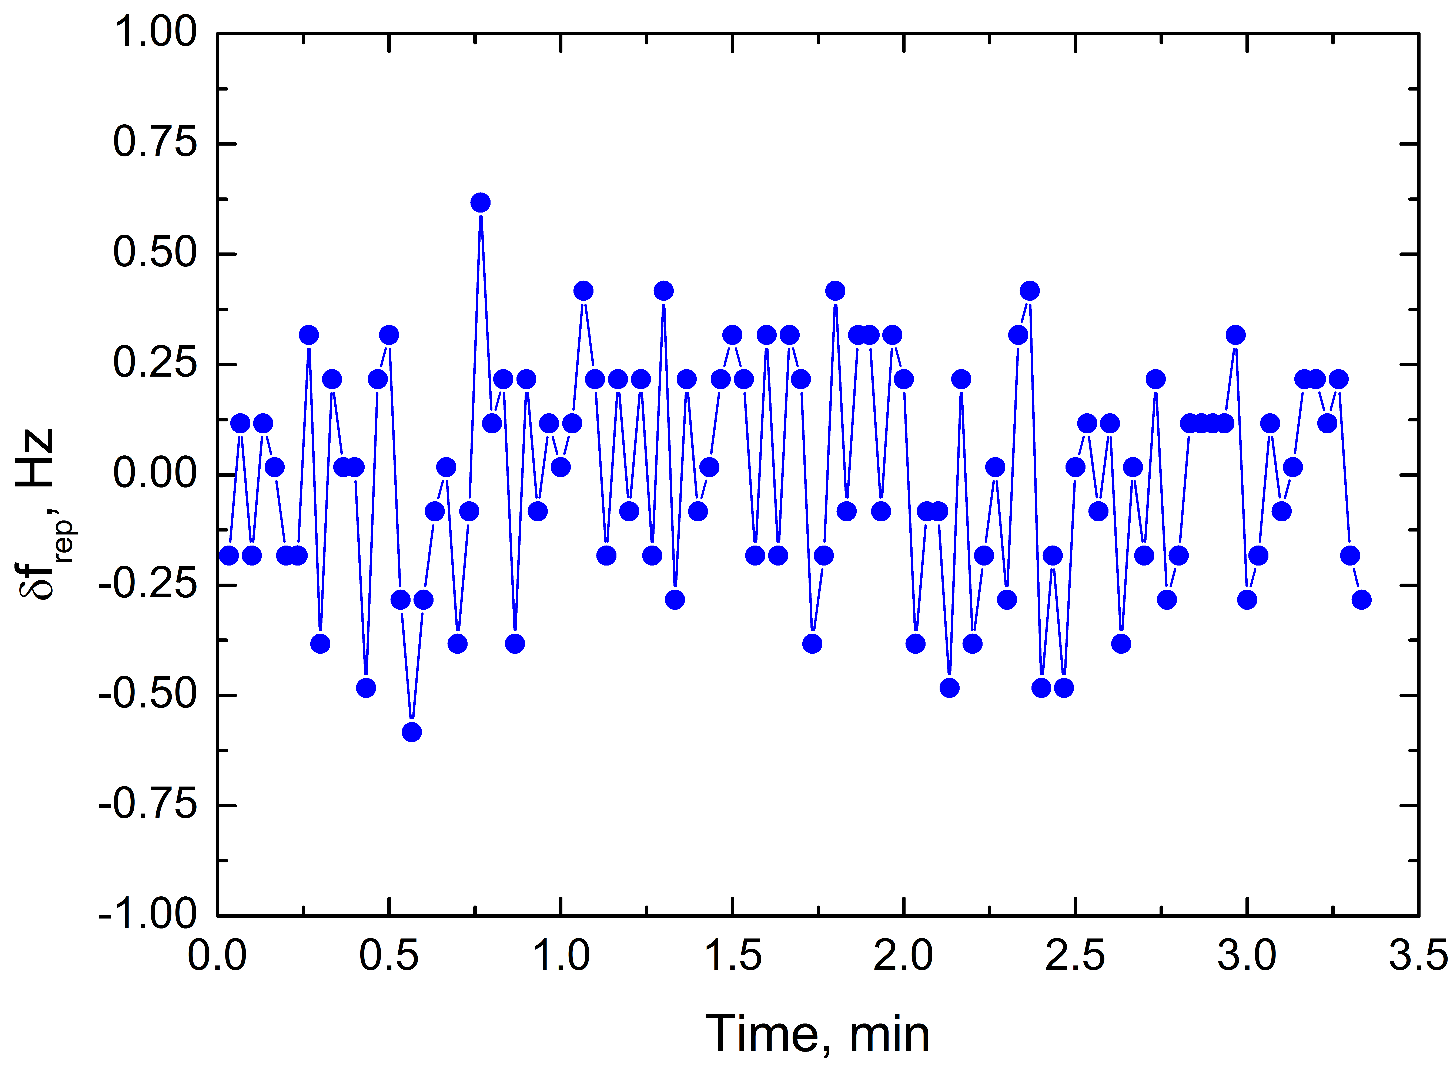
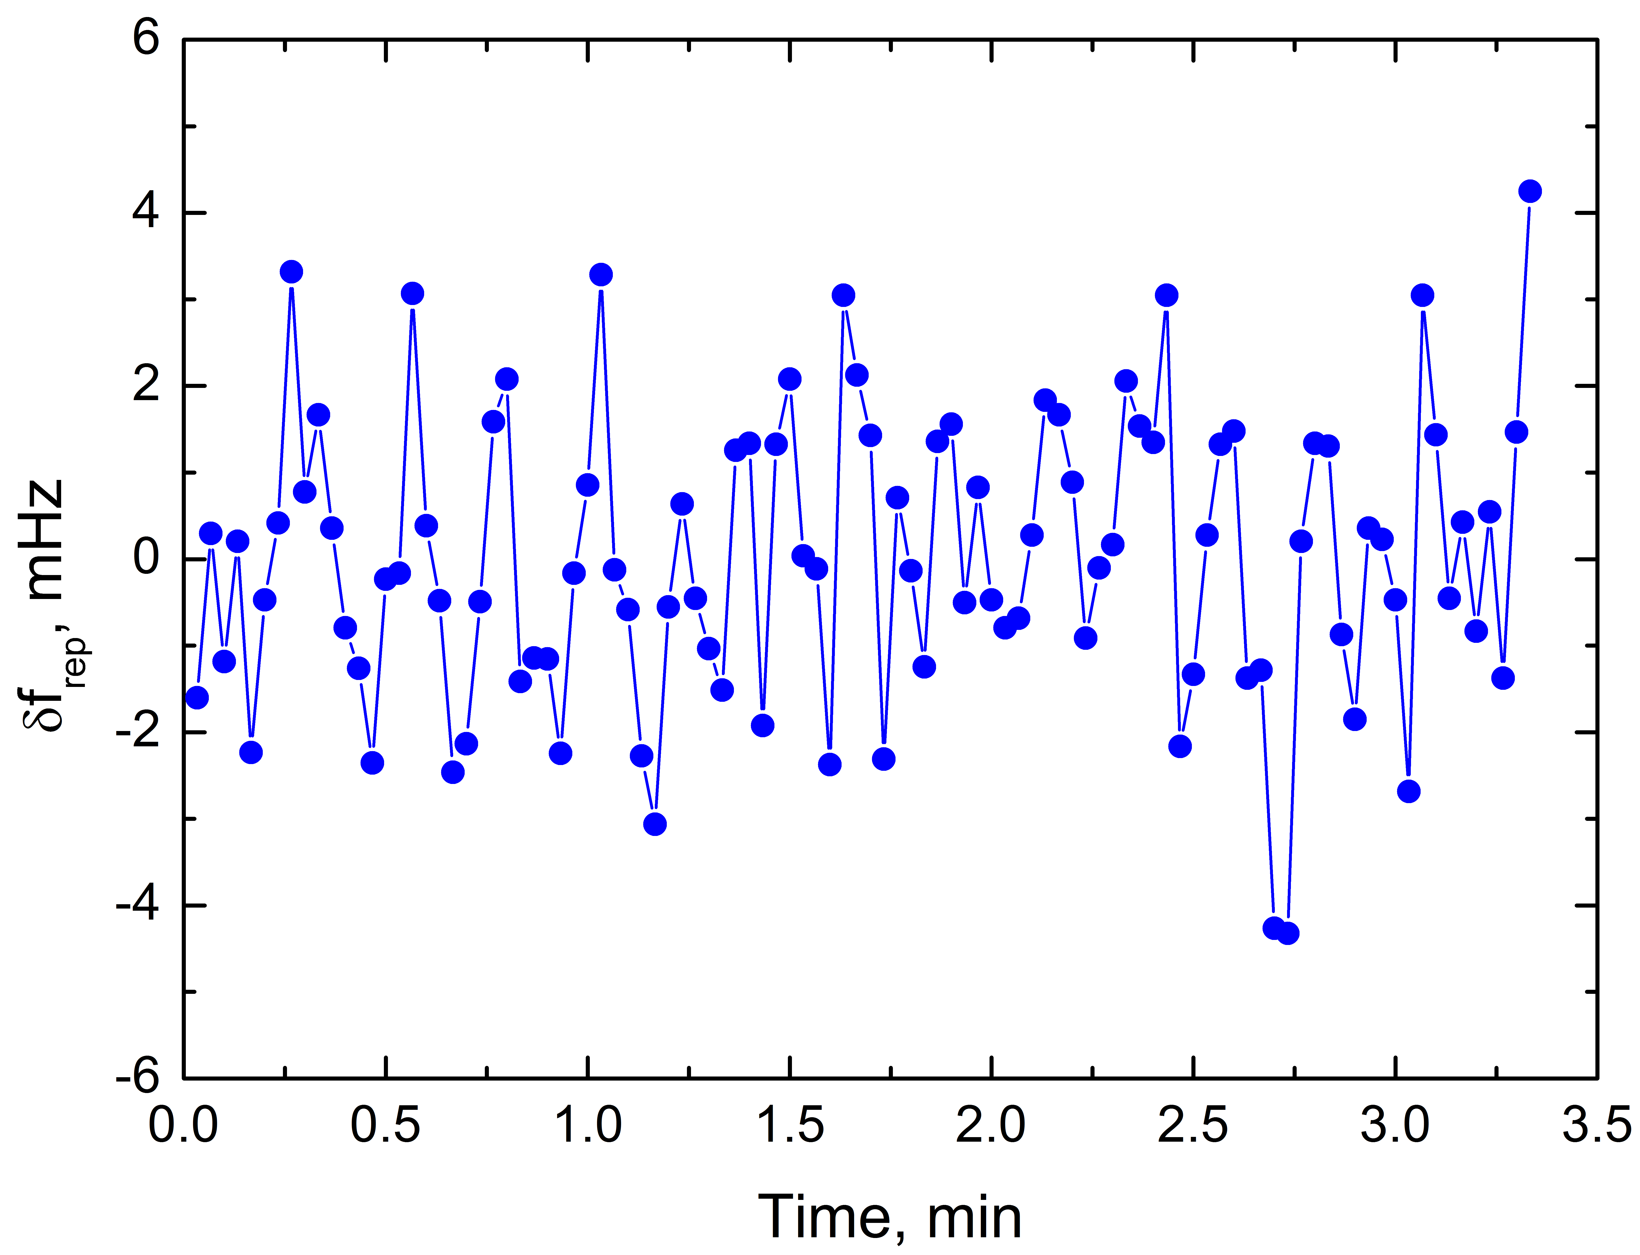
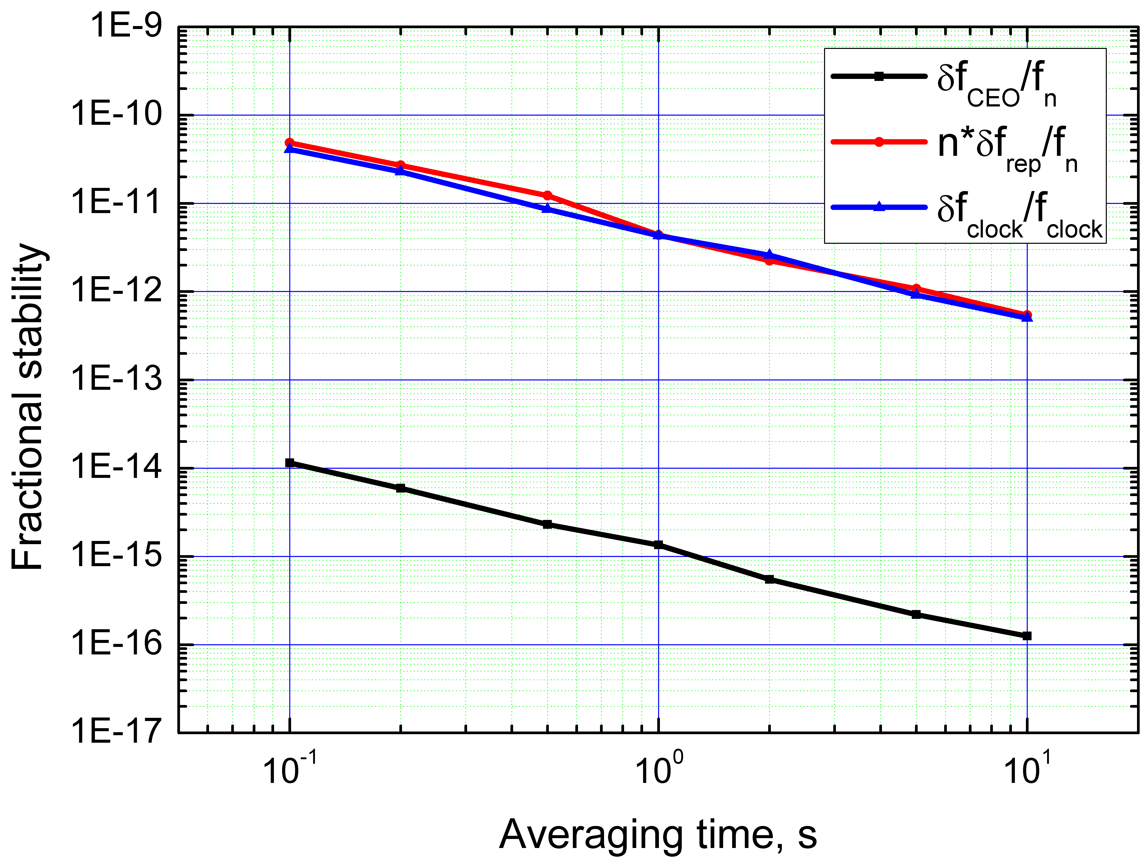
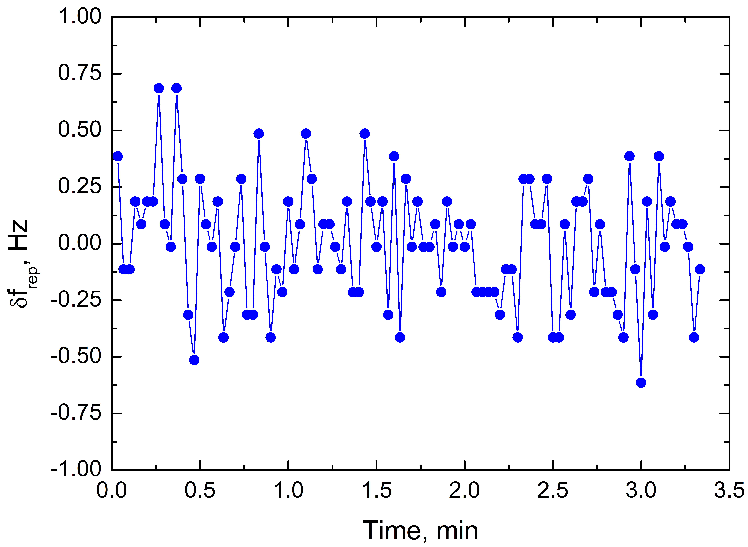
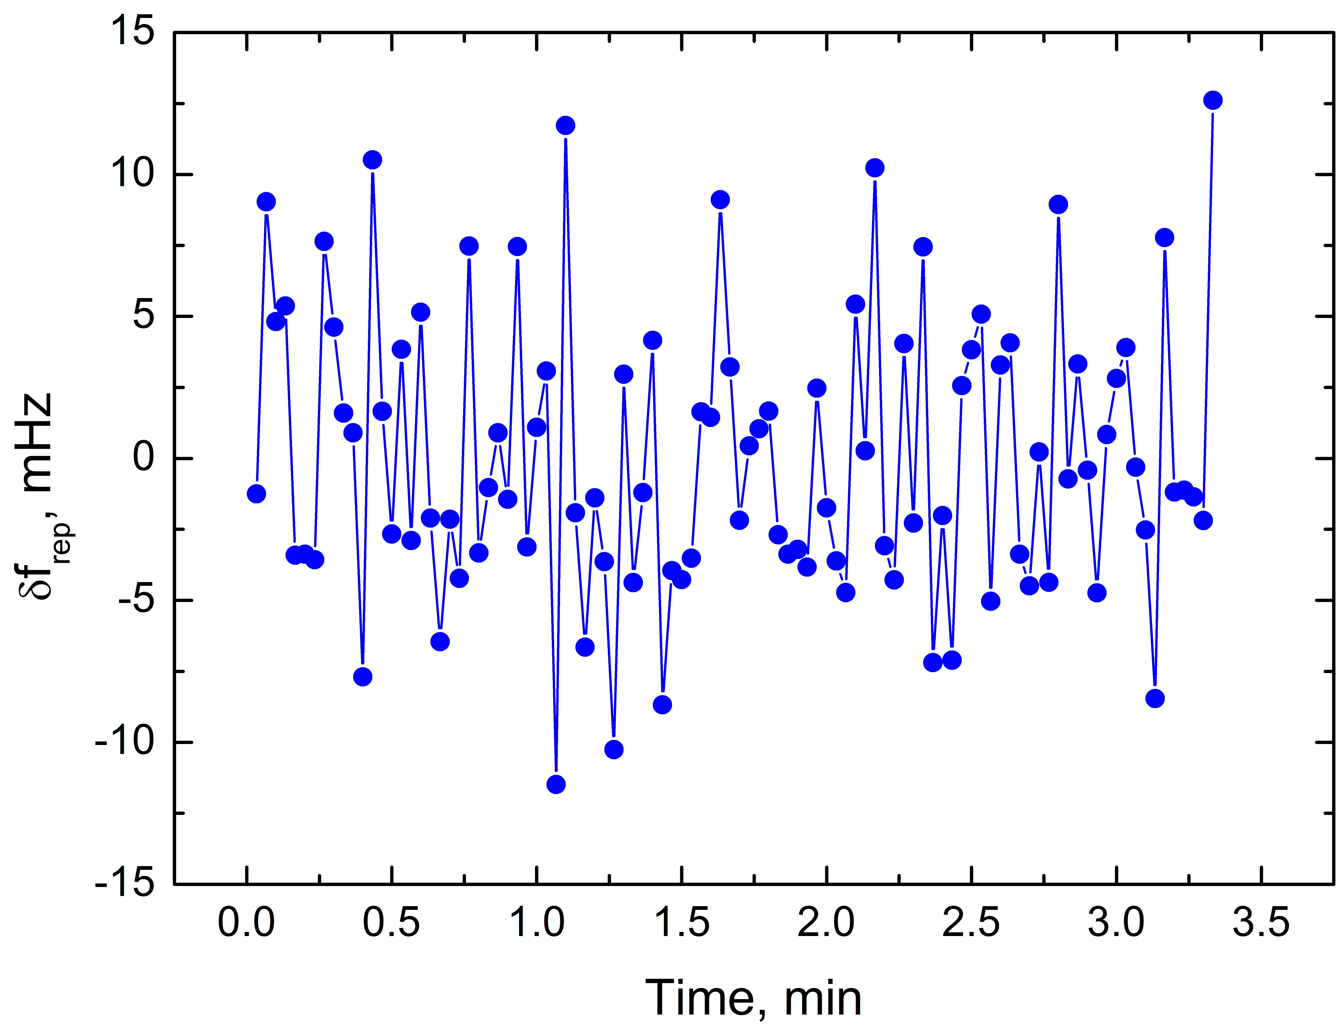
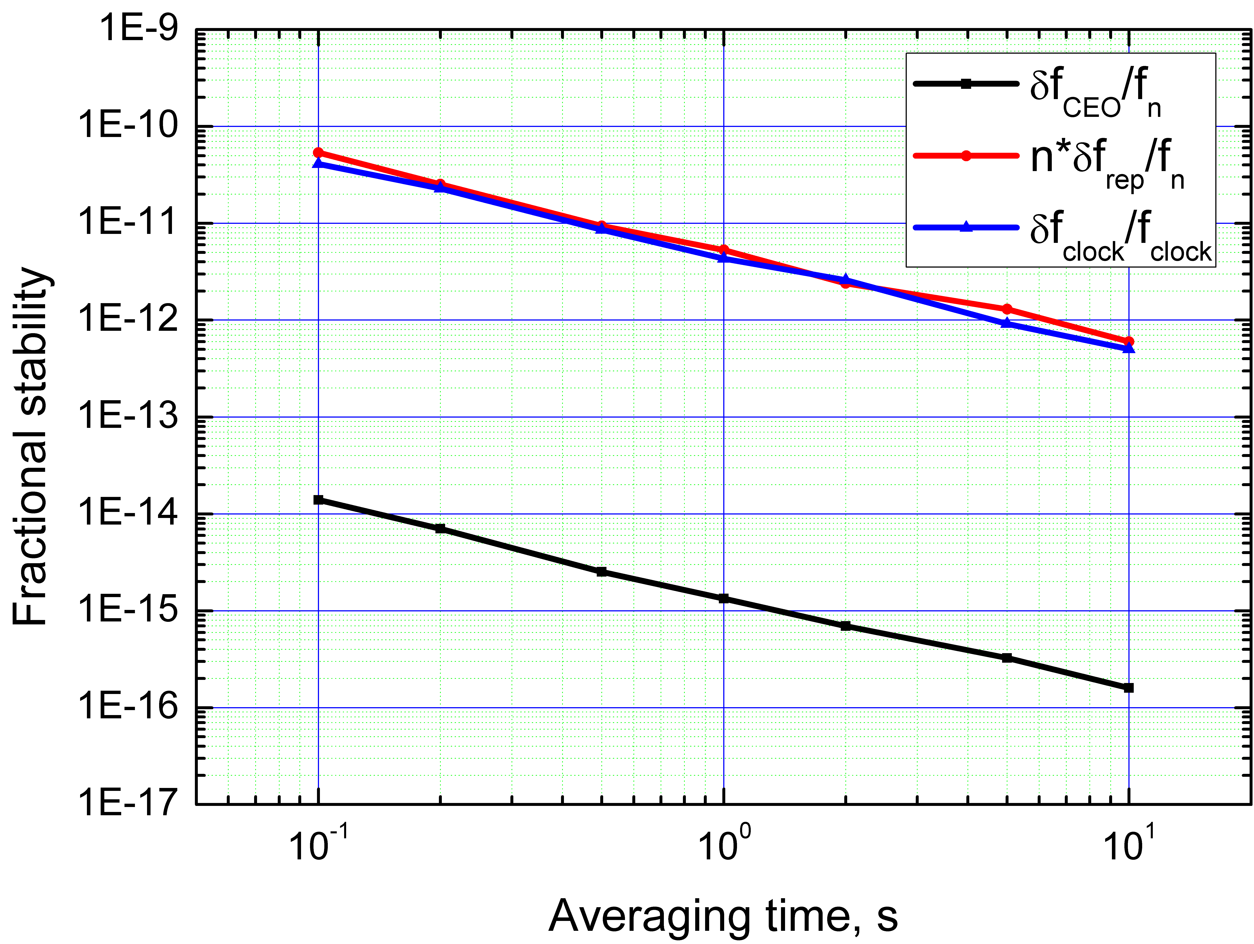
Comb stability characterisations: 333-MHz & 1-GHz OPOs
K. Balskus, R. A. McCracken, Z. Zhang and D. T. Reid submitted for publication
Harmonic operation does not compromise the frequency-stability of the comb
Modal stability limited by Rb-quartz reference oscillator to 5 x 10⁻¹² (1-sec gate)
0.27 Hz (1s)
δf_{clock}/f_{clock}
333 MHz
1.5 mHz (1s)
nδf_{REP}/f_{REP}
nδf_{REP}/f_{REP}
δf_{CEO}/f_{CEO}
δf_{CEO}/f_{CEO}
f_{CEO}
f_{CEO}
f_{REP}
f_{REP}
0.27Hz (1s)
5 mHz (1s)
δf_{clock}/f_{clock}
1 GHz

Slide 16
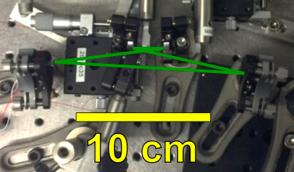
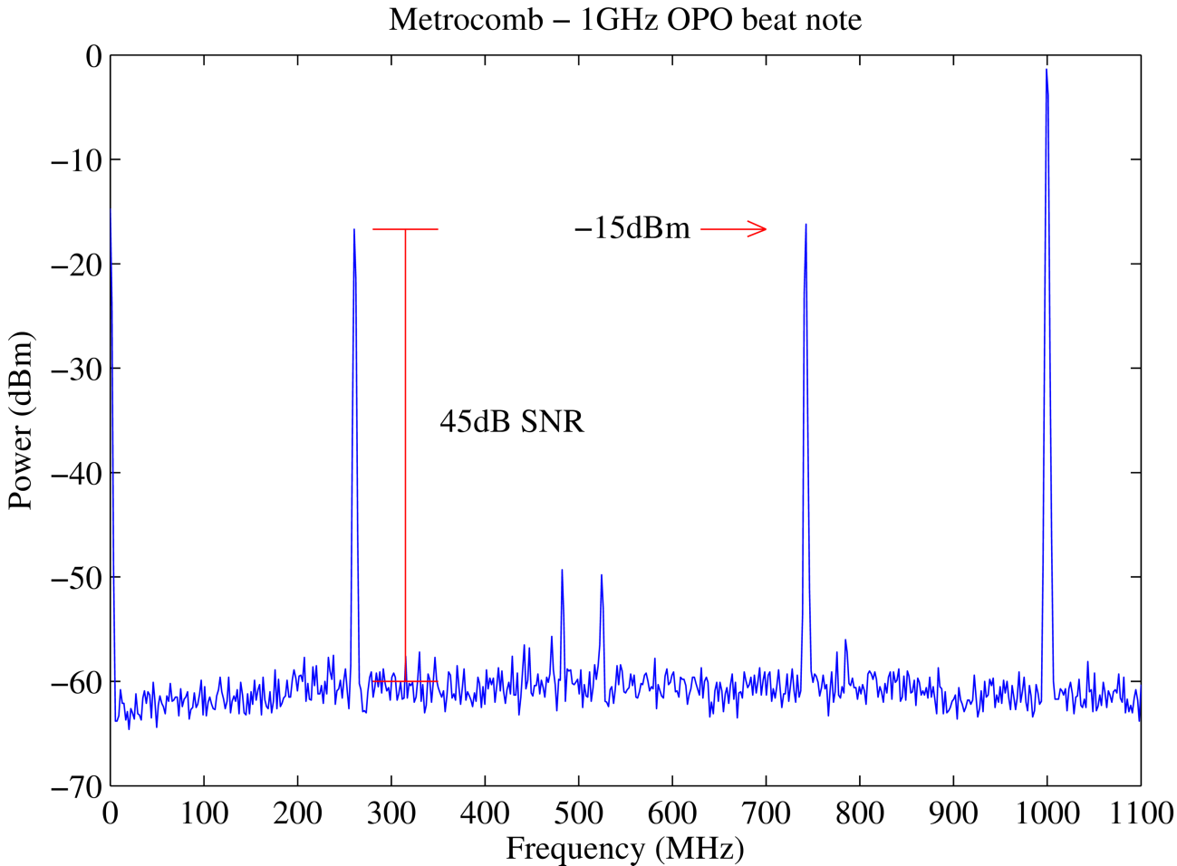
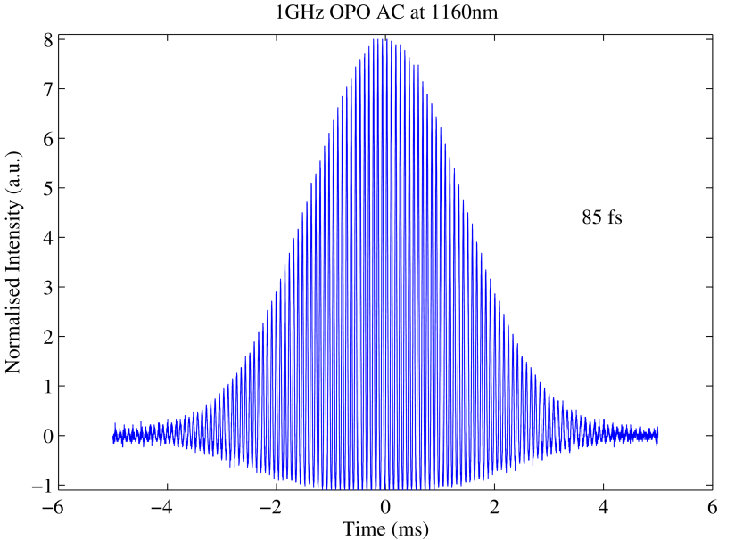
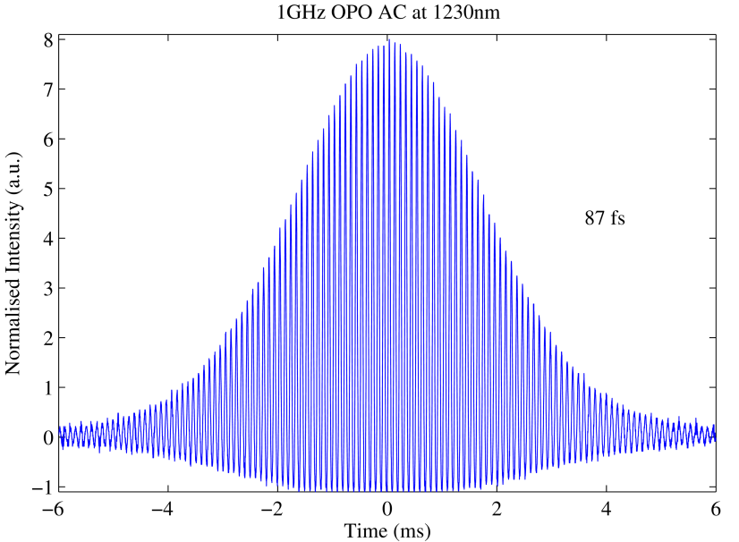
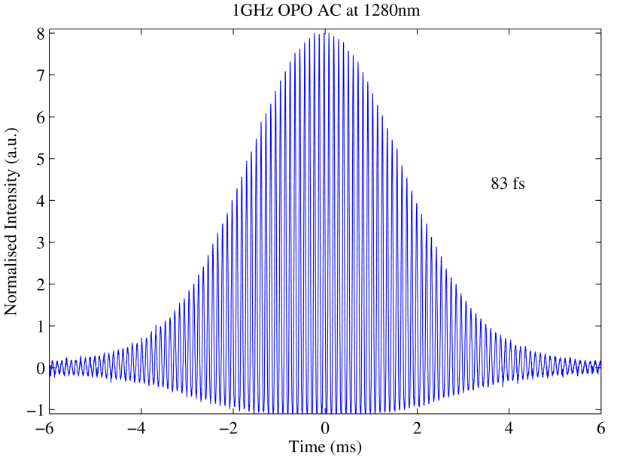
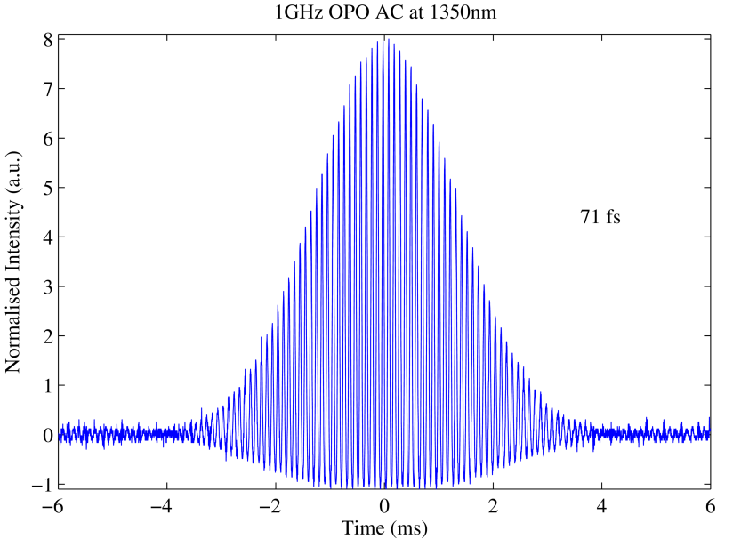
Towards higher mode spacings:
fundamentally-pumped 1-GHz OPO comb
Commercial 1-GHz Ti:sapphire pumps OPO directly at 1-GHz mode spacing
CEO interferometer
p, i + SFM
1 GHz
1.3 W
30 fs
Mirror on PZT
silica plate as OC
λ_{signal} 1160 nm 1230 nm 1280 nm 1350 nm
85 fs 87 fs 83 fs 71 fs

Slide 17
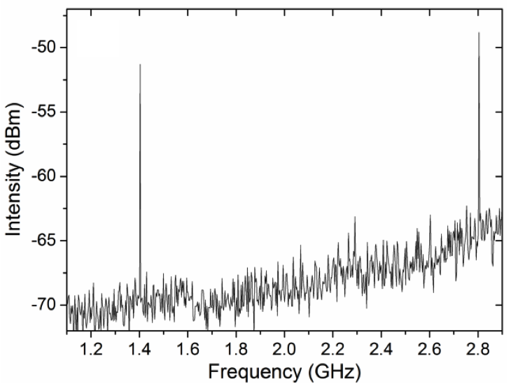
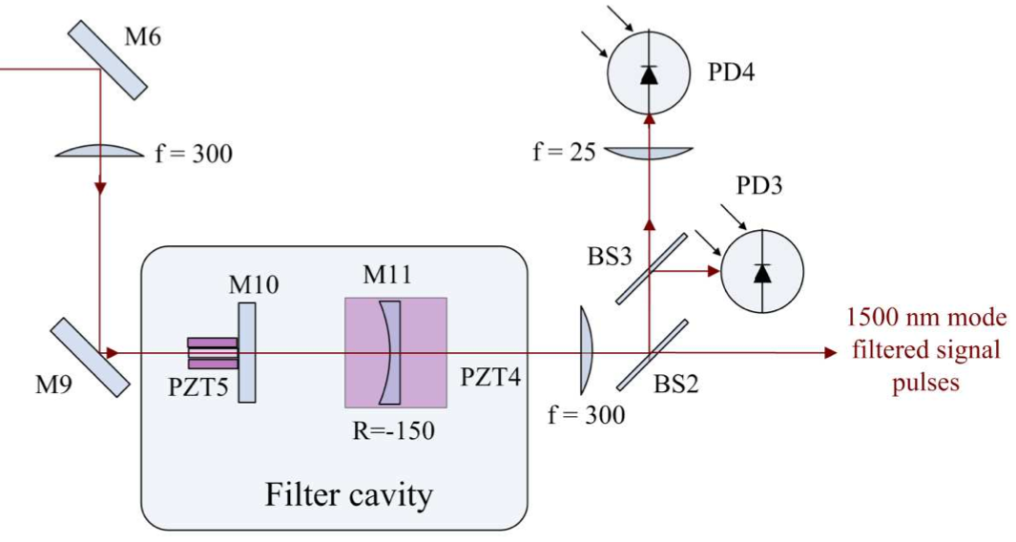
Towards higher mode spacings:
1.4 GHz OPO comb by Fabry-Pérot filtering
T. I. Ferreiro, T. P. Lamour, J. Sun and D. T. Reid, Electronics Letters 49, 833 (2013)
Fully stabilized 135-fs OPO frequency comb running at 280 MHz mode spacing
8 x f_{REP} referenced to 2.24-GHz Rb-stabilised microwave synthesiser
Comb offset frequency referenced to a 10-MHz output from the same source.
5x mode filtering (proof-of-principle) in a plano-concave Fabry-Pérot cavity (FSR 1.4 GHz)
OPO frequency comb
λ = 1500 nm
Δt_{p =} 135 fs
f_{REP} = 280 MHz
f_{CEO} = 10 MHz
-50
PD2
f = 300 mm
f = 25 mm
-55
Intensity (dBm)
PD1
-60
M1 M2
-65
PZT1
-70
Filtered signal pulses
λ = 1500 nm
f_{REP} = 1.4 GHz
Fabry-Pérot filter cavity
1.2 1.4 1.6 1.8 2.0 2.2 2.4 2.6 2.8
Frequency (GHz)

Slide 18
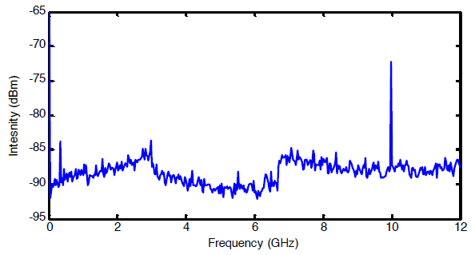
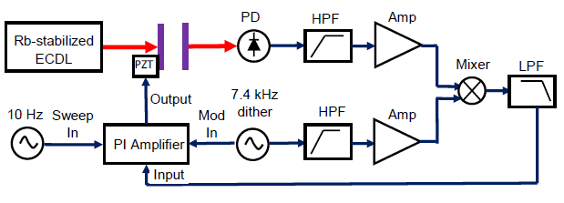
Towards higher mode spacings:
Fabry-Pérot filtered 10-GHz OPO comb
RMS length stability of < 0.25 nm
RF spectrum of the filtered output
Variance = 0.5%
333 MHz OPO comb (1.35-1.55 μm)
10 GHz comb (1.35-1.55 μm)

Slide 19
Conclusions
OPO combs
provide wavelengths which are (at best) marginal from existing laser combs
can multiply laser mode spacings by harmonic pumping
can reach 1 GHz and potentially up to 10 GHz directly, without F-P filtering, with potential advantages of lower noise and better sideband suppression
Ongoing research attempting to demonstrate multi-GHz comb operation over an extended wavelength range
Doubly-resonant OPO architecture expected to enable 10-GHz operation
Direct stabilisation to a Rb optical transition will ensure traceability of comb line frequencies, without f-to-2f stabilisation
Applications beyond spectrograph calibration such as dual-comb spectroscopy
Acknowledgements
Dr. Jinghua Sun, Barry Gale, Dr. Teresa Ferreiro, Dr. Richard McCracken,
Dr. Tobi Lamour, Dr. Zhaowei Zhang, Karolis Balskus, Stuart Leitch.
Notes:
Core expertise in our group is the frequency conversion of modelocked lasers using optical parametric oscillators (“OPOs”) which allow a near-IR laser to be converted into the mid-IR, or (via frequency doubling) into tunable visible light. In 2007 our group was the first to extend the femtosecond frequency comb concept to OPOs, building a comb that spanned 400nm – 2400nm.
Since then we have refined the concept, paying particular attention to understanding the stability available from such OPO combs. We showed that a pump laser with no full comb stabilisation could be used to create a fully stabilized OPO comb, then we measured a stability of around 100 Hz in the optical comb line at 1.5 µm. The linewidth of the individual comb lines is very narrow, since the OPO has no gain storage. The image on the right shows a measurement of a 15-Hz linewidth.
Our current direction of travel is to increase the intermode spacing using Fabry Perot filter cavities, and also to investigate direct routes to higher repetition rates by using direct optical frequency referencig, e.g. to a hyperfine transisition in Rb vapour.
The requirements for the ELT are for comb spacings from 6 GHz (mid-IR) to 30+GHz (uv/visible). We can envisage a combination of OPO and laser routes to address these requirements. Mode flattening filters or even line-by-line shaping should be possible at these repetition rates.

