Slide 1


Integrated Photonic Spectrographs
Dr. Roger Haynes
Photonics for Planets 2014
Florence, 5th November 2014
Part of the research leading to the results presented has received funding from the Federal Ministry of Education and Research (Grant No. 03Z2AN11/12) and the European Community's Seventh Framework Programme (FP7/2013-2016) under grant agreement number 312430 (OPTICON)
www.innofspec.de

Slide 2
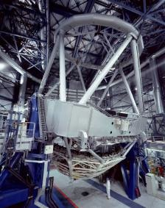
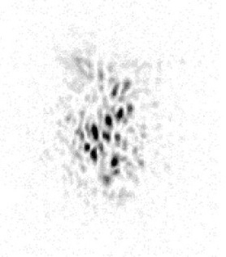
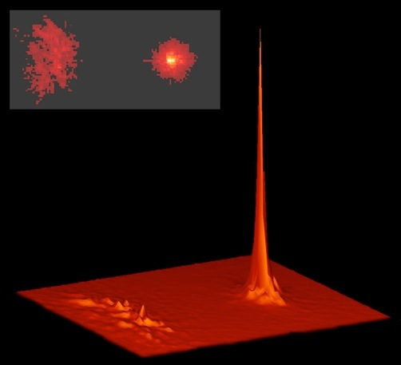
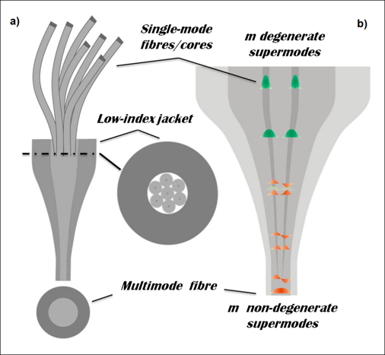
Telescope coupling
MM fibre for efficient coupling
Star
PSF
large
perturbed
Telescope
Efficient coupling requires MM fibres
Photonic functions require SM fibres
Solution: multimode-to-single-mode converter
Photonic Lantern
Leon-Saval, S., Birks, T., Bland-Hawthorn, J., Englund, M. (2005). Optics Letters, 30(19), 2545-2547.

Slide 3
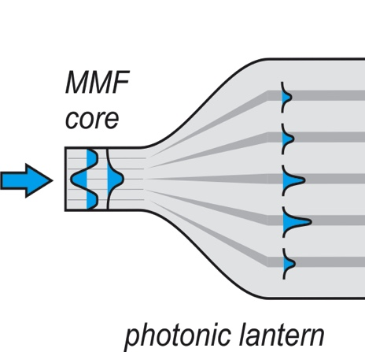

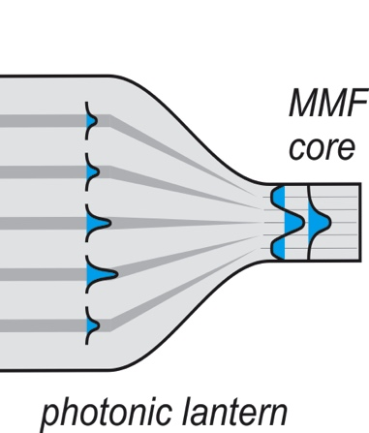
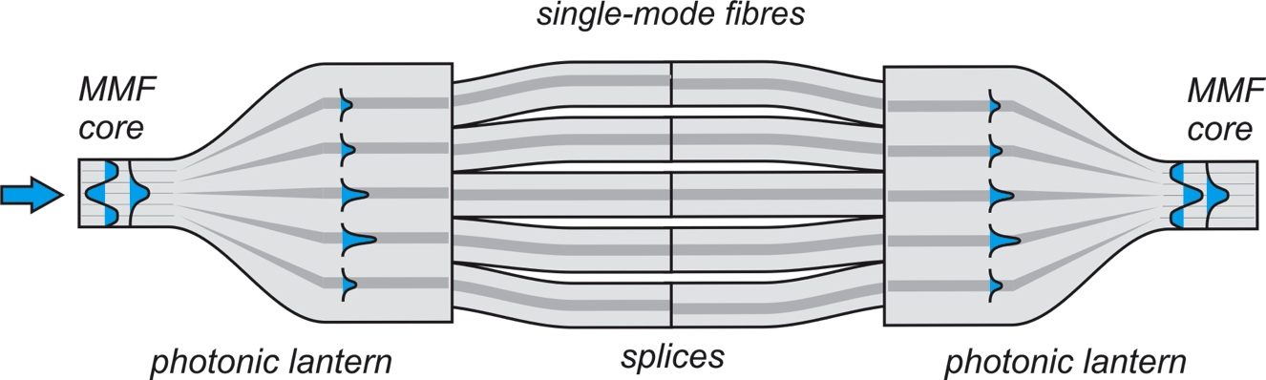

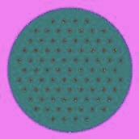
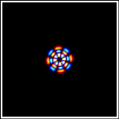
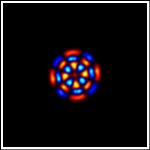
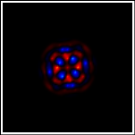
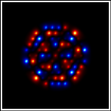
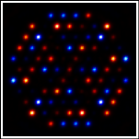
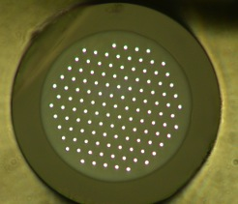
Types of Photonic Lantern
Motivation
Working at diffraction limit (SM)
Enables photonic functions
Efficient telescope coupling
Modal noise suppression
Notes:
1) Simulation of Mode 42 of MMF propagating from a MMF region to 85 SM core array
2) MCF re-formater
3) 3D Photonic Lanterns
3) Long Slit SM Coupler

Slide 4
3D & Hybrid Photonic Lantern

Slide 5
Photonic Lantern Coupled Spectrograph
The PIMMS instrument concept
J. Bland-Hawthorn et al,
Proc. SPIE 7735, 77350N (2010)
Reformatting slit of spectrograph into single mode via photonic lantern
Spectrograph can use conventional optics or photonics
Trade slit length for slit width
Narrow slit allow diffraction limited performance
Conventional Spectrograph: Small diameter and relative cheap optics
Integrated Photonic Dispersion: Arrayed Waveguide Gratings
Spectrograph design becomes independent of telescope parameters

Slide 6
Diffraction Limited Spectrograph
Diffraction limited from the ground
Use AO System to provide near-diffraction limited PSF
Losses due to imperfect correction
Losses from PSF to spectrograph aperture alignment
Use Photonic Lantern to convert to single mode regime
May require many modes
8m, 0.5 as, H-Band: ~100
8m, 0.5 as, Visible: ~1000
Combine limited AO correction with photonics
Lower order AO with a few mode photonic lantern

Slide 7
PL: MM to SM slit re-formatting
N = number of SM cores
The multimode fibre core has the same area as the single mode fibre cores
Number of multi-modes = Number of single-mode cores
SM fibre has √N smaller diameter than MM fibre
SM system will give lossless √N higher R, if d limited
If SM are adjacent and without any gap for cladding
SM slit is √N longer than MM slit
For adequate λ sampling SM pixels must be √N smaller than MM
SM needs N more pixels than MM, unless pixels are rectangular
SM: Ideally √N smaller pixels, but rectangular and √N more pixels

Slide 8
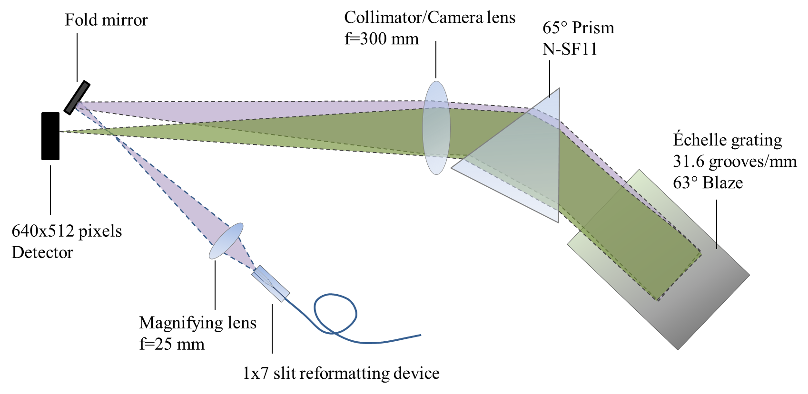




Single-mode échelle spectrograph

Slide 9
IPS (AWGs)
Motivation
Stability
Diffraction Limited
Modularity
Mass Production

Slide 10
IPS (PEGs)

Slide 11
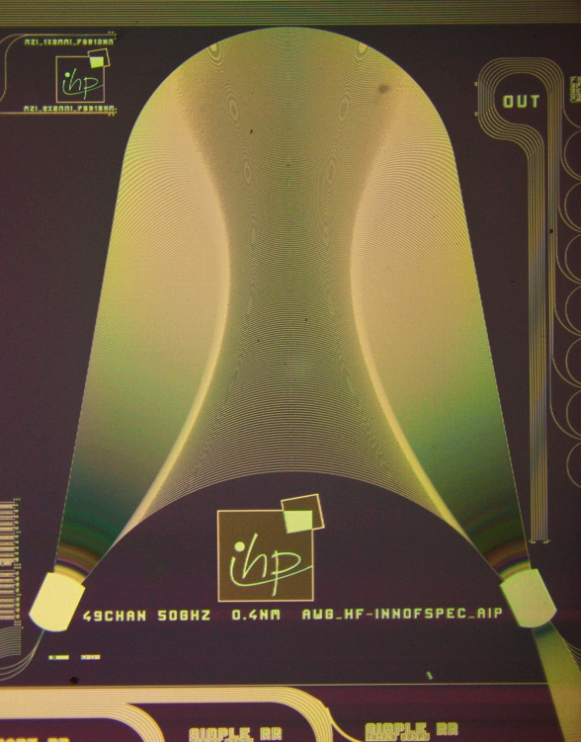
Integrated Photonic Spectrograph (IPS)
Single order device or λ sensitive X-dispersion
Single fibre per chip
Linear detector
Stacking gap issues
Stack IPS devices
Anamorphic optics
2D detector array

Slide 12
Optimised IPS
Multiple off-axis inputs, spectra fill output
Each channel corresponds to PL SM output
Depends on off-axis performance
Inputs correspond to PL SM outputs
Multi-channel, Multi-stack IPS array
PIMMS Concept

Slide 13
IPS first light on sky at AAT
IRIS2 infrared spectrograph at the AAT
Coupling to the telescope via Photonics Lantern and µm-lens array
No external cross disperser as thermal background noise would have been to too high without cooling
Used IRIS2 cold slit and cold stop to baffle thermal background from IPS and re-imaging optics
IRIS2 Grism used for Cross-Dispersion
IRIS2 Hawaii-1 as the Detector

Slide 14
IPS on sky results

Slide 15
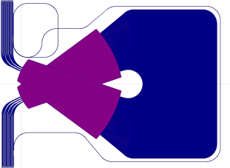
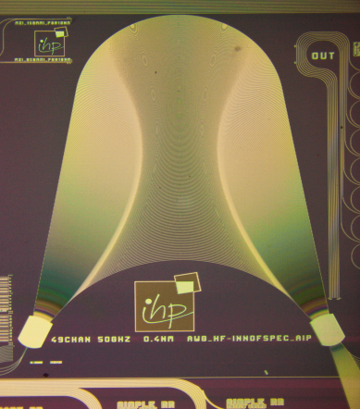
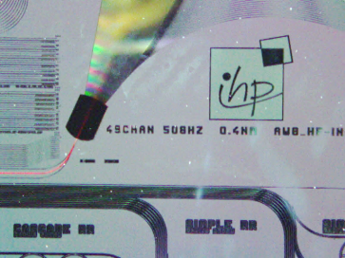
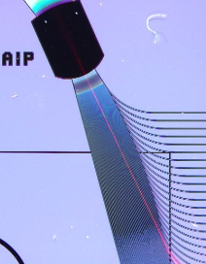
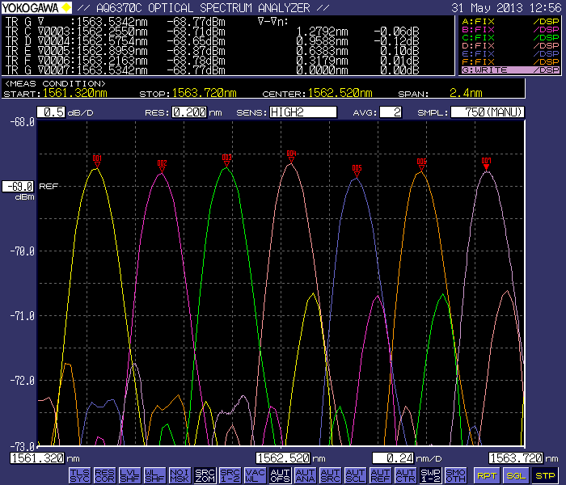
Astronomy customised IPS
Custom high-R astronomy design
Integrated Interferometer
High-resolution IPS: SoS Technology (Δn=1.5%)
Comprehensive re-design of traditional Arrayed waveguide grating: Folded-AWG Architecture
Radial velocity: exoplanet and stellar seismology …
Central wavelength: λ₀=1630nm (H-band)
Resolution (Theoretical): R = λ/Δλ ~ 60,000 (Δλ=0.025nm)
Free Spectral Range (Bandwidth): ~ 16nm
Small footprint (5.3 x 4.1 cm²): compact design
Low material losses and SMF 28 fibre compatibility
Reduction of birefringence and phase errors
4.1cm
5.3cm
SoS based, high-R, folded AWG IPS with integrated interferometer.
Left: SiN4 IPS, Middle: Image of input coupling, Right: Output Coupling
Measured output spectrum
Δλ=0.34nm, FSR=16.7nm

Slide 16

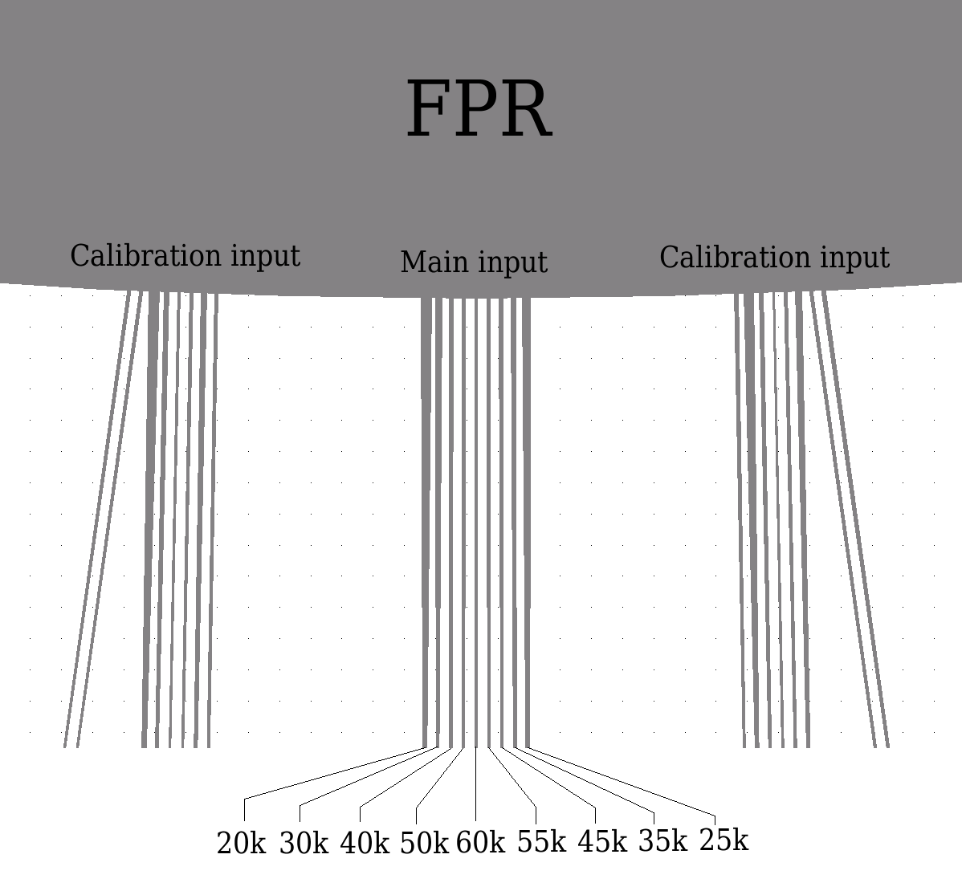
Astronomy customised IPS
Wavelength: 1500nm-1800nm
λ_{c}:1630nm
Grating order: 99
AWG length steps: 111.2µm
R = λ/Δλ: 20k-60k in 5k steps
Spectral resolution: 25pm-81pm
Integrated Interferometer
CAD mask layout
High resolution IPS
Low resolution IPS

Slide 17
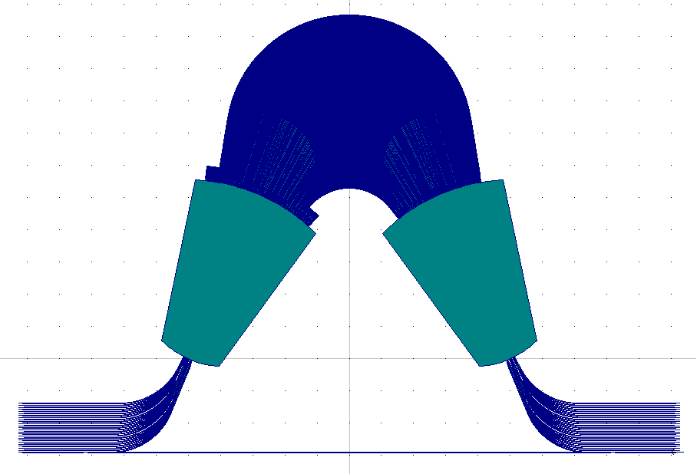
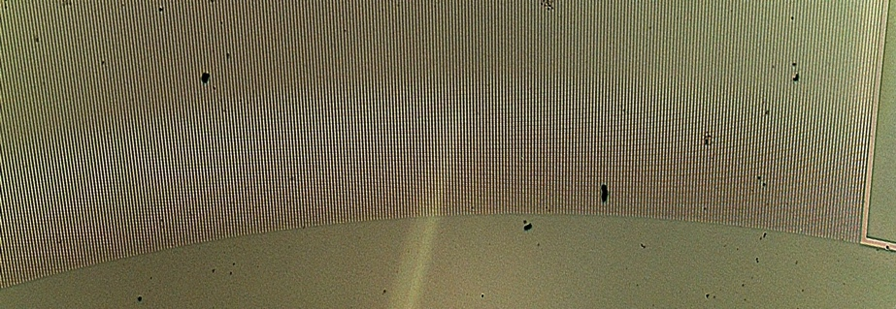
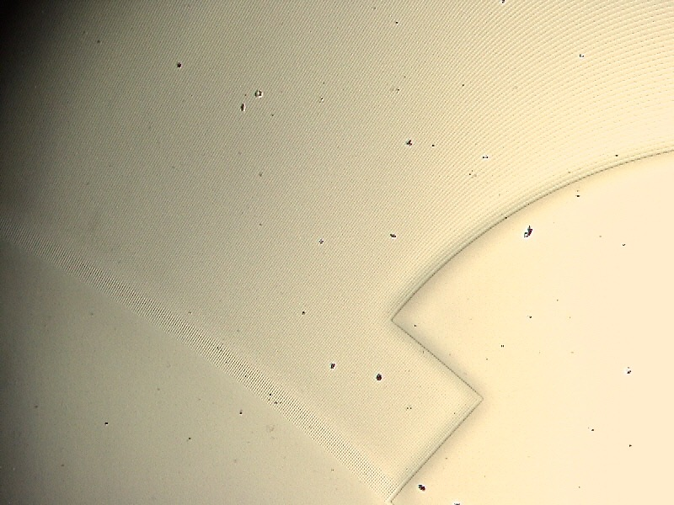
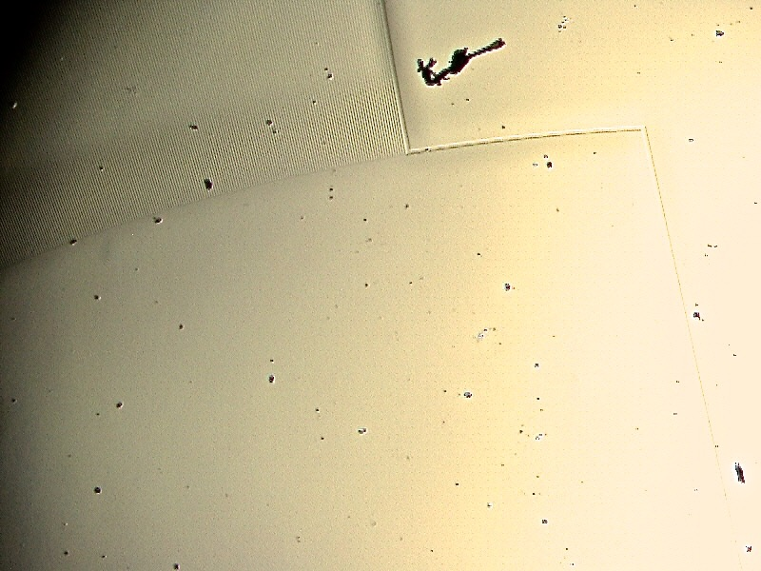
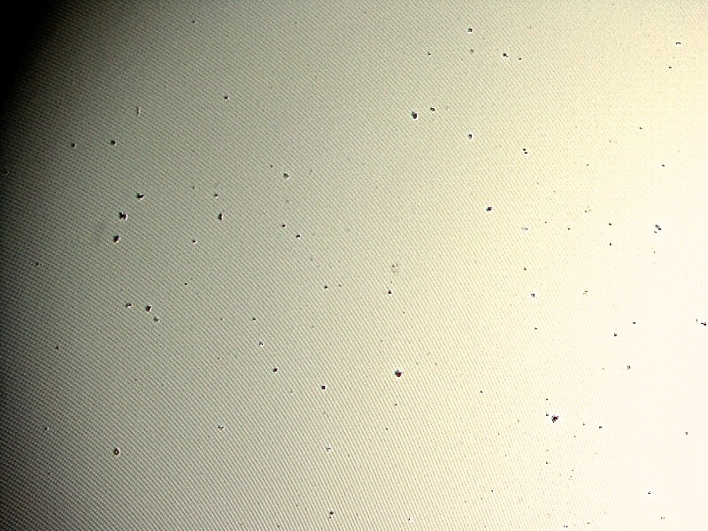
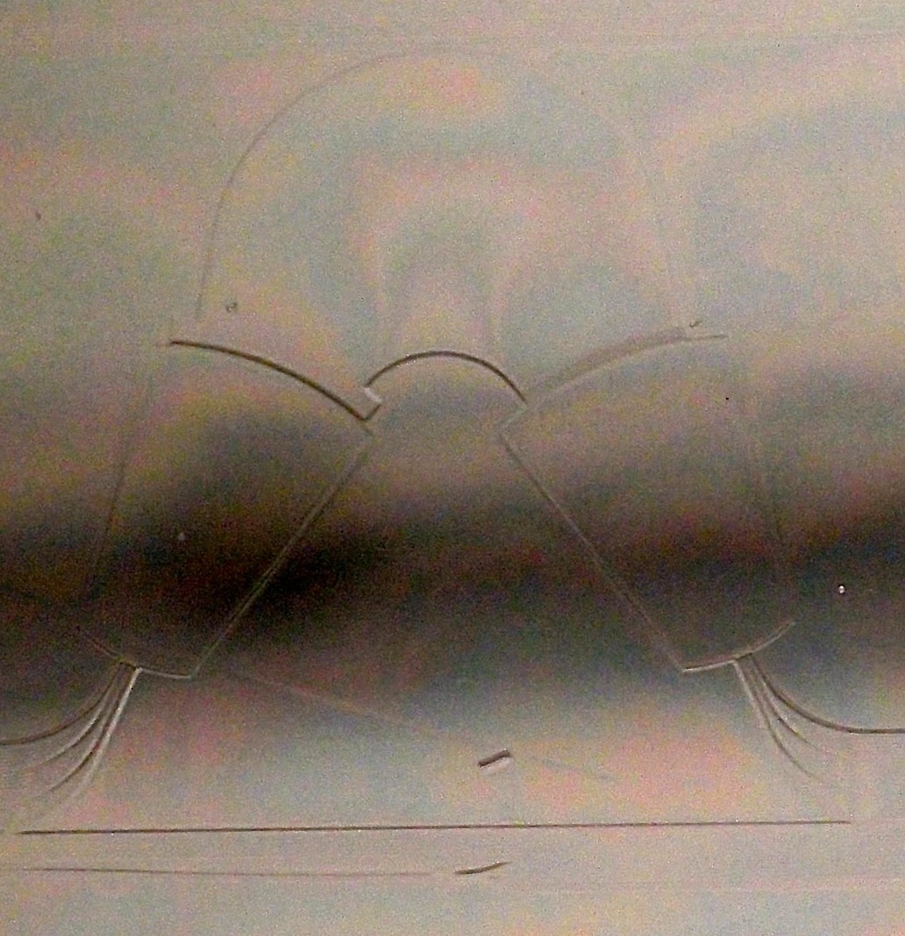
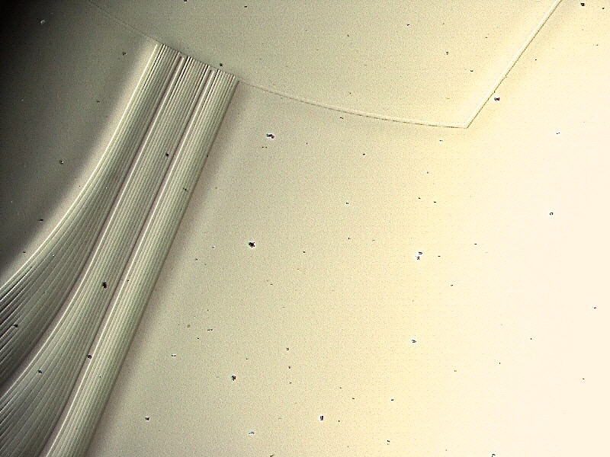
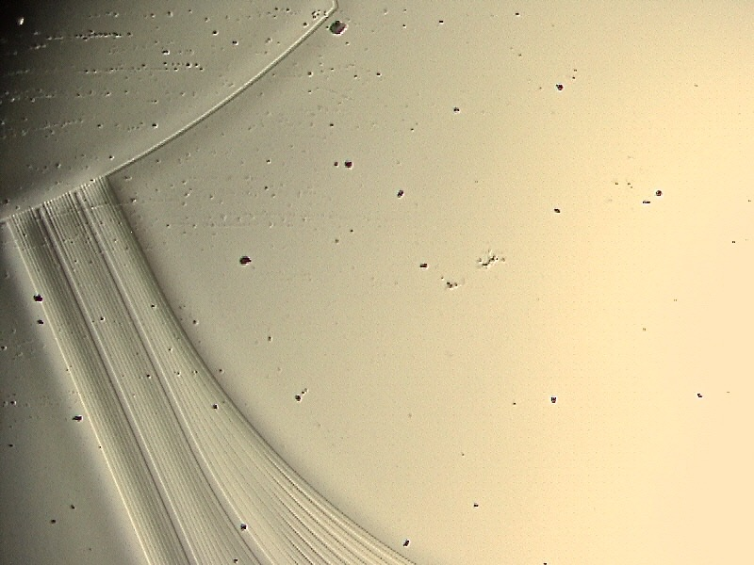
Astronomy customised IPS
4.1cm
2.7cm
Integrated interferometer
Mid-Resolution IPS: SoS Technology (Δn=1.5%)
Conventional symmetric geometry
Central wavelength: λ₀ = 1630nm (H-band)
Resolution: R = λ/Δλ = 7,000-15,000 (Δλ = 0.11nm-0.23nm)
Free spectral range: 32nm
No. of arrayed waveguides: 400
Small footprint (2.7 x 4.1 cm²)
Focal length (FPR length): L_{f} = 1.11cm
Low material losses and SMF 28 fibre compatibility
Reduction of birefringence and phase errors

Slide 18
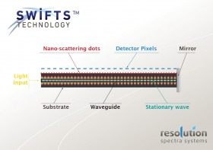
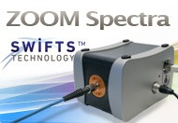
SWIFTS
http://www.resolutionspectra.com
Wavelength range 630 to 1083 nm
Wavelength bandwidth one measurement 5 nm (at 630 nm) - 14 nm ( at 1083 nm) Optical Spectral resolution R ~125,000 (0.005 – 0.015 nm)
Absolute wavelength Accuracy 0.001 - 0.002
Aperture Singlemode fiber N.A. 0.12
Input power range 10nW – 1 mW
Wavelength Calibration Factory calibration - Temperature calibrated on the range 10°C - 40 °C (external environment)
Integration time 320 ns to 500 ms / 32 ns step
Maximum Measurement rate 30 000 frame/s
Dimensions 8.3 cm x 8.6 cm x 12.6 cm
Power consumption 11W – 500mA @ 24 VDC
Communication Gigabit Ethernet

Slide 19
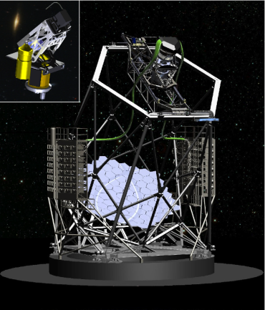

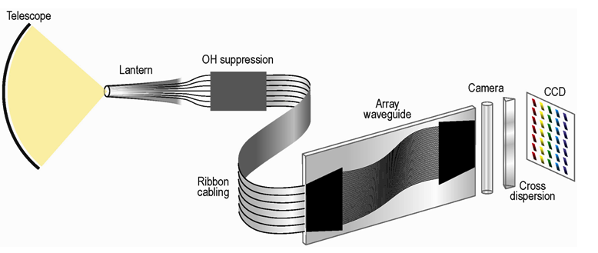

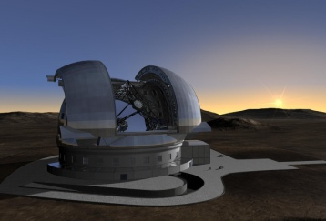
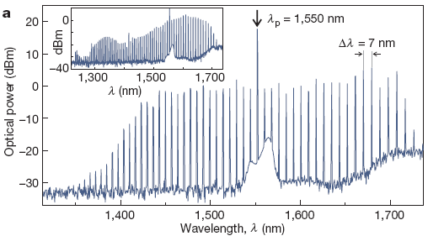
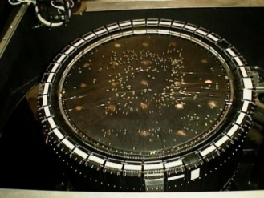
Photonic Spectroscopic System
Notes:
PIMMS Vision

Slide 20






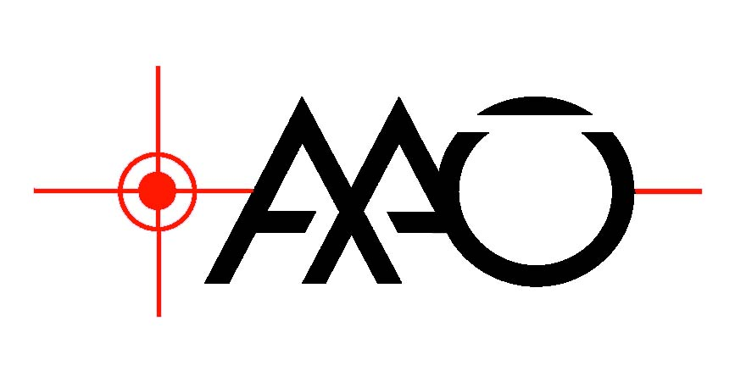
Many thanks
Additional slide material from:
Chris Betters, Tim Birks, Joss Bland-Hawthorn, Pierre Kern, Jon Lawrence, Jeremy Allington-Smith, Robert Thompson, & the innoFSPEC-AIP Team

