Slide 1


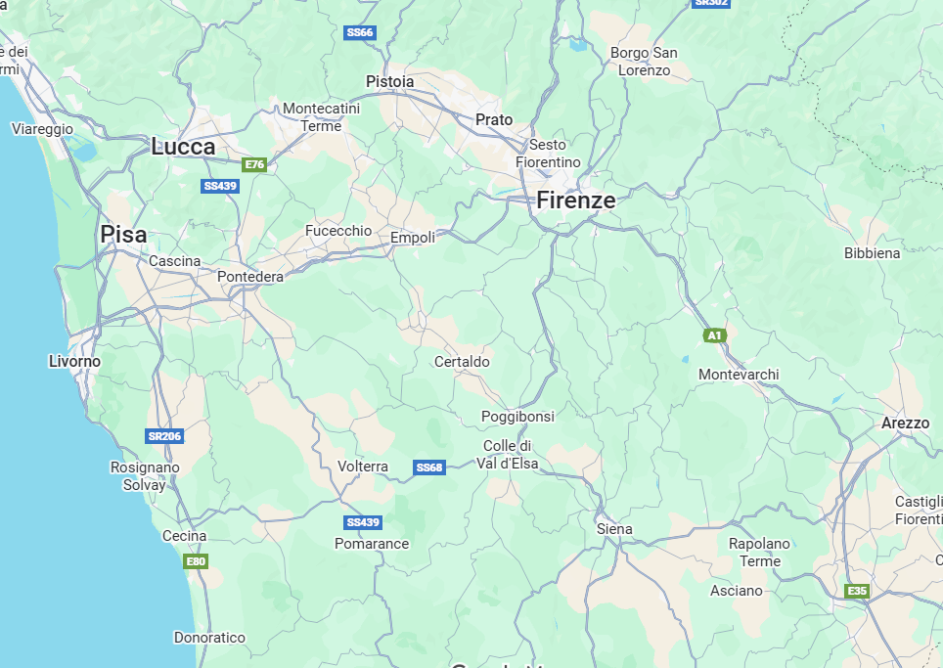



BACKGROUND AND FORMATION
Name: Francesco Renzi
Date of birth: January 31, 2001
Hometown: Terranuova Bracciolini (AR)
BACHELOR DEGREE: University of Pisa – Sept. 2019, Jul. 2022
Curriculum: Physics
Thesis title: ‘Zona abitabile circumstellare’
Supervisor: Prof. Pier Giorgio Prada Moroni
MASTER DEGREE: University of Pisa – Sept. 2022, Feb. 2025
Curriculum: Astronomy and Astrophysics
Thesis title: ‘Laboratory analog experiments to support detection of organics on Mars by deep UV Raman spectroscopy’
Supervisors: Prof. John R. Brucato, Prof. Teresa Fornaro,
Prof. Angelo Ricciardone
Notes:
Good morning to everyone, I’m Francesco Renzi the new PhD student that will work with John (Brucato) in its astrobiology laboratory.
Just some very quick information about my background: I was born in 2001 (so I’m 24 now), in Terranuova Bracciolini, which is a small town just in between Florence and Arezzo as you can see from the map. I grew up in Terranuova and moved for the first time to start the university in Pisa in 2019. I had my bachelor in physics in 2022 and the same year I started the master in ‘Astronomy and Astrophysics’ which I concluded this february.
Even if I was in Pisa I started to be really fascinated about astrobiology, so I contacted John and came here to do my master thesis, which was about organic matter in martian soil simulants.

Slide 2
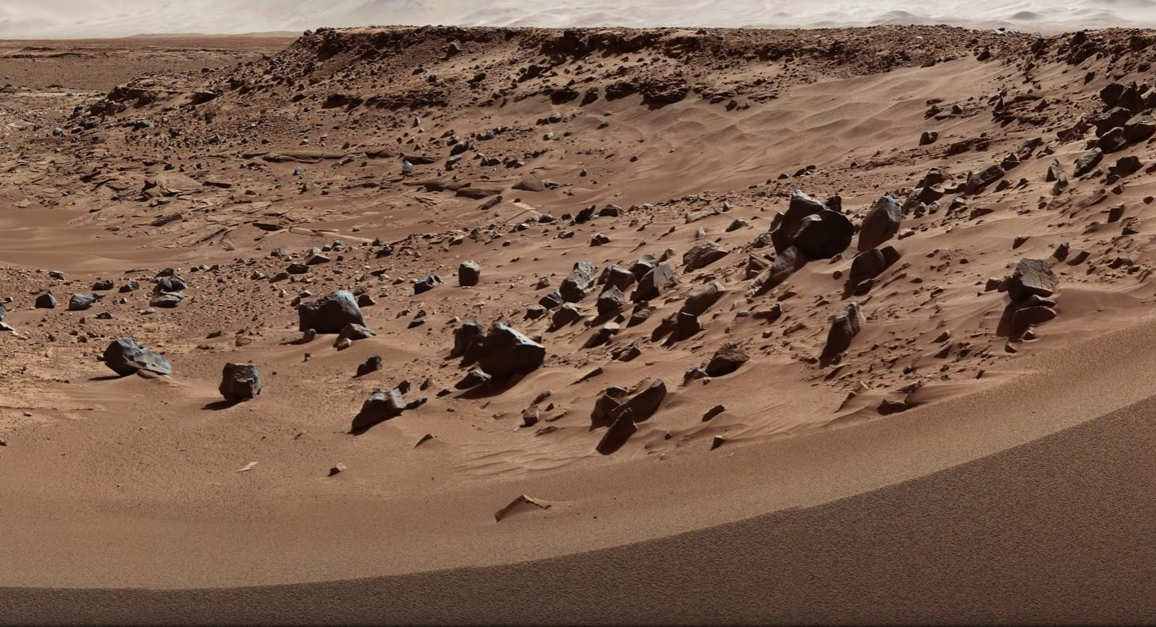
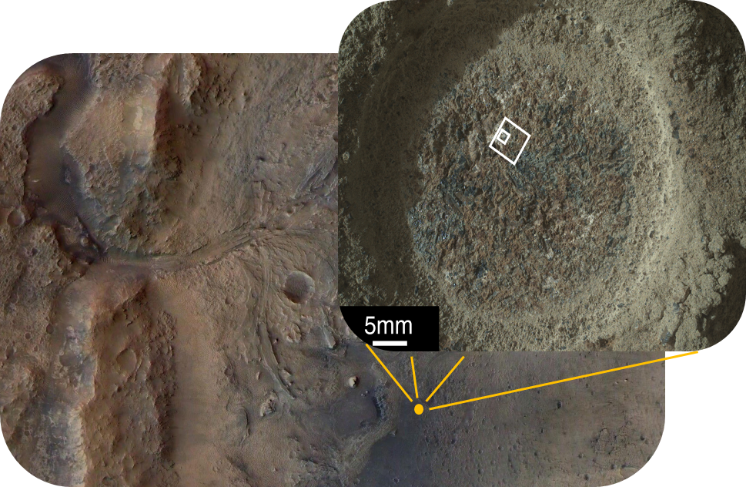
MASTER THESIS
OBJECTIVES:
Support the identification of organics on Mars by NASA MARS2020 Perseverance Rover
Help to validate a theoretical model for quantification of deep-UV Raman spectroscopy and estimate possible organic concentration on Mars
QUARTIER
MAIN RESULTS:
The analyzed organics are good canditates to be the origin of Raman features observed by Perseverance
Tested model potentially works
JEZERO CRATER
Notes:
Indeed my thesis work was done in support to the Perseverance rover, which is part of the NASA Mars 2020 mission and it’s currently operative on Jezero crater on Mars. Specifically, Perseverance detected some features that fall within the range expected for organic compounds in the exact spot that you see on the photo, which was named ‘Quartier’.
My main objective was to create Martian analog samples and include two organic molecules that were considered strong candidates to be the source of the observed features in Quartier. Then I ran some experiments on these samples in order to verify the position of these molecules as strong candidates.
Moreover, since I was dealing with Raman spectroscopy in the deep ultra violet I also helped to verify a model about quantification of deep UV Raman that could in theory predict organic concentrations directly on Mars.
The main results that came up from this work are that both analyzed organics remains good candidates to be the source of Quartier organic signals and that the tested model potentially works.

Slide 3
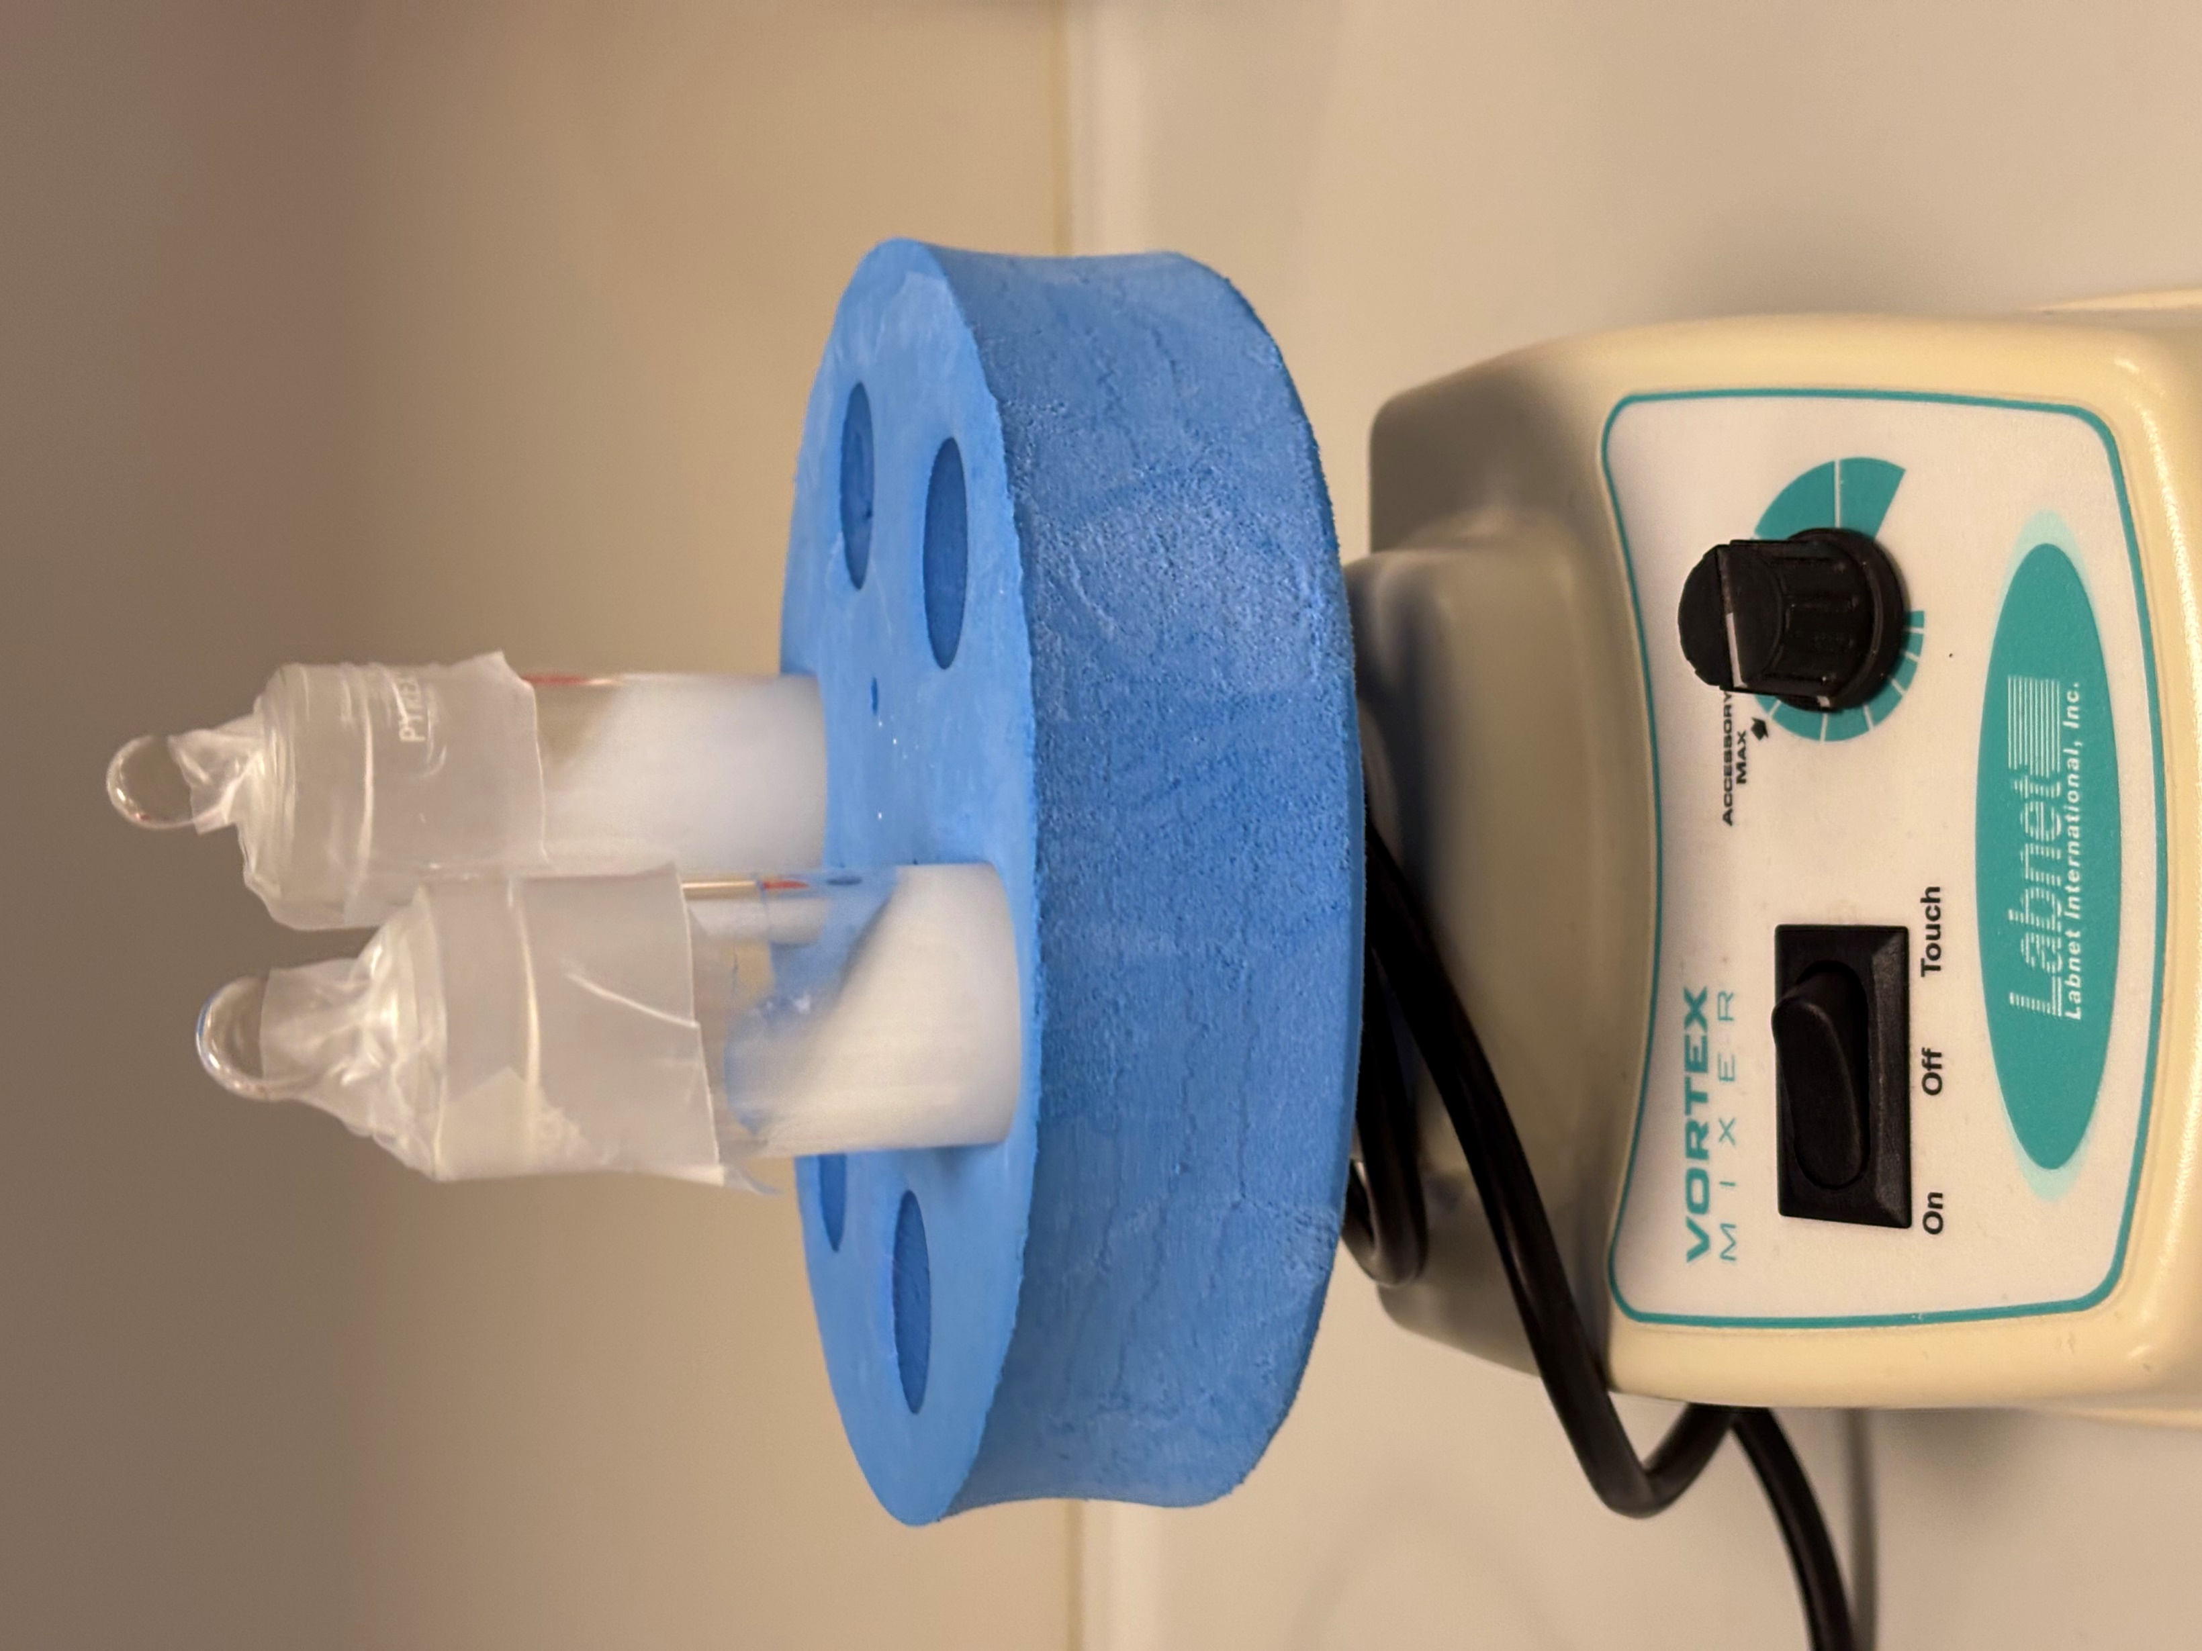
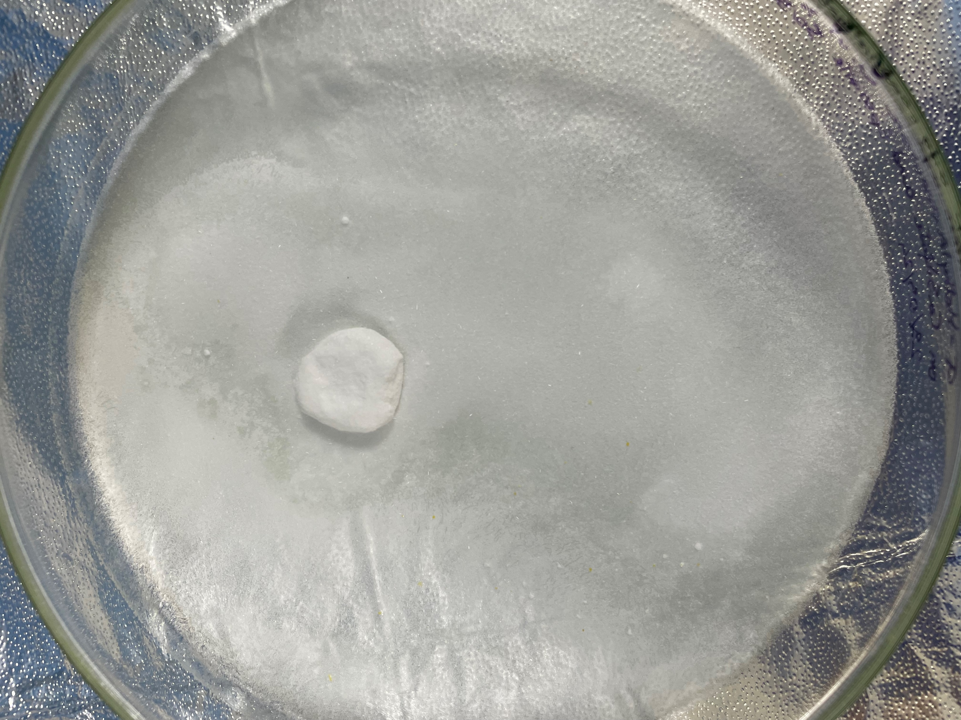
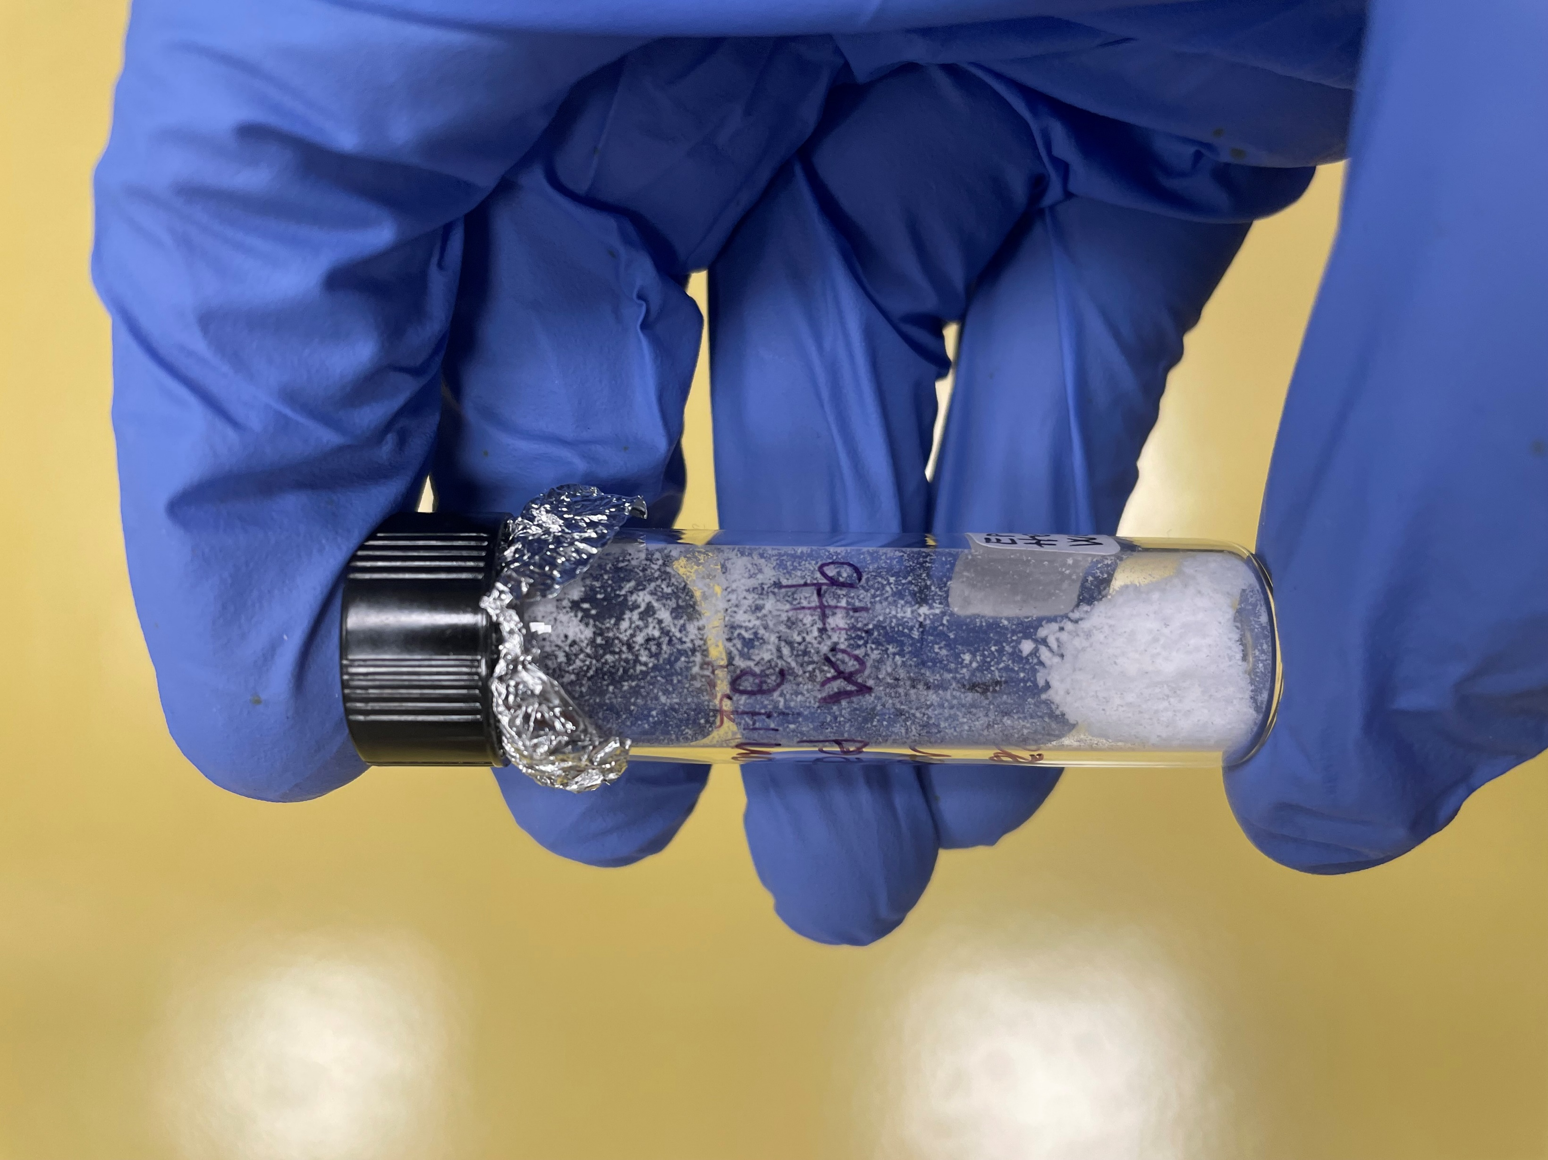
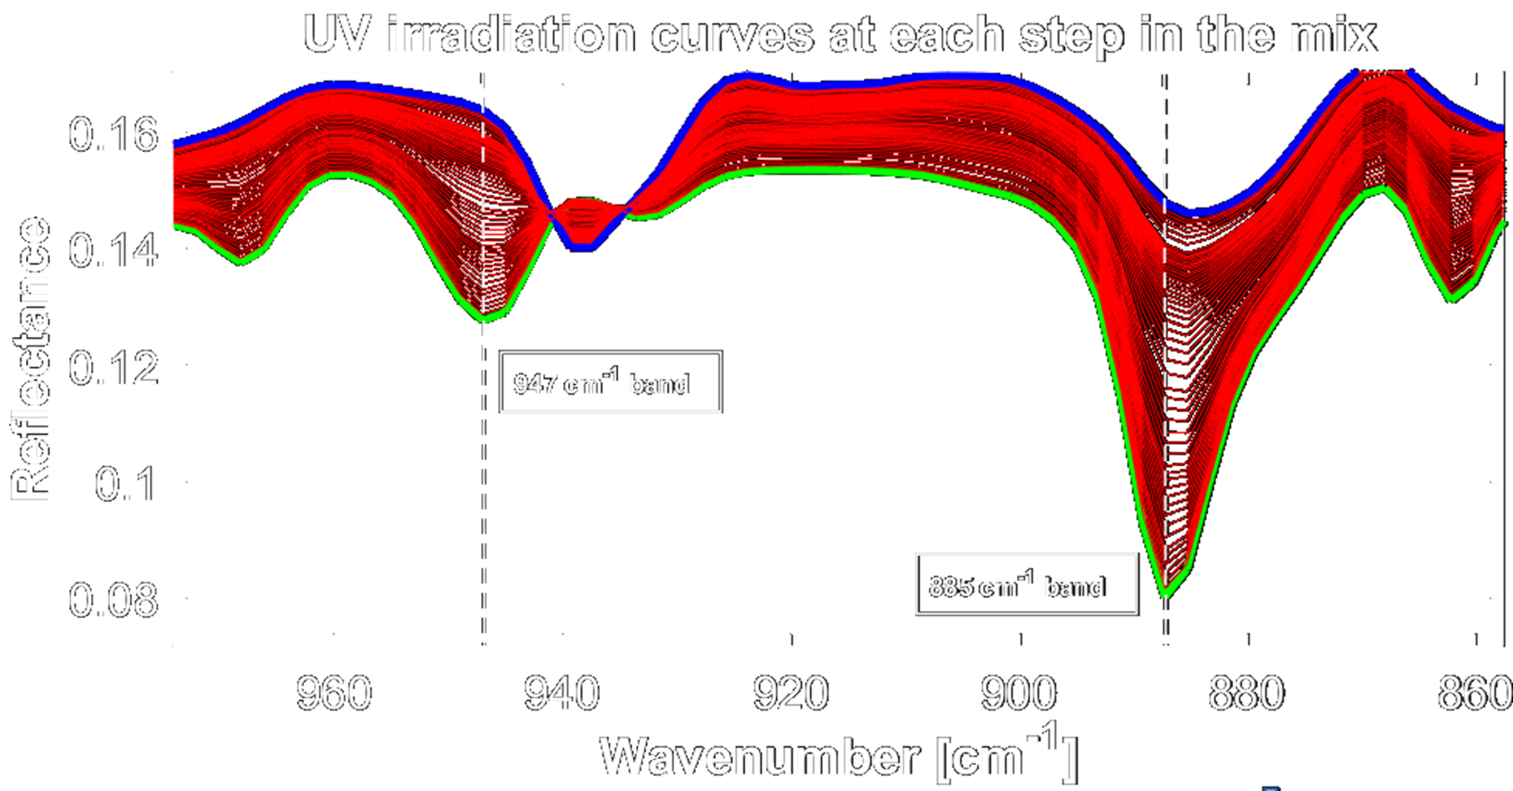
MARS SAMPLE RETURN SUPPORT
InfraRed and Raman characterization to study mineral-molecule interactions and support interpretation of data from space missions
Creation of Martian analog samples including organics under relevant Martian conditions^{[1]}
Experiments of simulated Martian UV irradiation to monitor the response of organic molecules and the role of mineral substrates in protecting/degrading organics and driving chemistry^{[2][3]}
[1] T. Fornaro et al. (2013); [2] T. Fornaro et al. (2020); [3] A. Alberini et al. (2024)
State of the art of sample return:
Analysis of asteroid samples returned on Earth through NASA OSIRIS-Rex and JAXA Hayabusa2 missions
Support to Mars Sample Return (MSR) campaign performing laboratory studies for the characterization of martian samples collected by Perseverance
Development of protocols and methods for sample curation facility
Notes:
Switching now directly onto what will be my phd project, I will work for the next three years in the field of sample return. Sample return missions are the ones that succesfully brought back to Earth, or intend to in the next years, pristine samples from extraterrestrial bodies. Nowadays the state of the art of sample return comprehend primarly analysis of samples from asteroids Bennu and Ryugu that returned on Earth thanks to NASA OSIRIS-Rex mission and JAXA Hayabusa2 mission, but also laboratory studies to support the Mars Sample Return champaign, which is a series of missions that aim to bring back samples collected by Perseverance on Mars.
In this context the first part of my project will regard Mars and the sample return champaign, which makes my PhD a natural consequence of my master thesis. Indeed, I will continue to create Martian analog samples with relevant organics in order to charactrize them with infrared and Raman spectroscopy to study mineral-molecule interactions and support interpretation of data from space missions. Moreover I will perform experiments of simulated Martian UV irradiation on these samples to monitor the response of organic molecules and the role of mineral substrates in protecting or degrading organics and in driving chemistry.

Slide 4
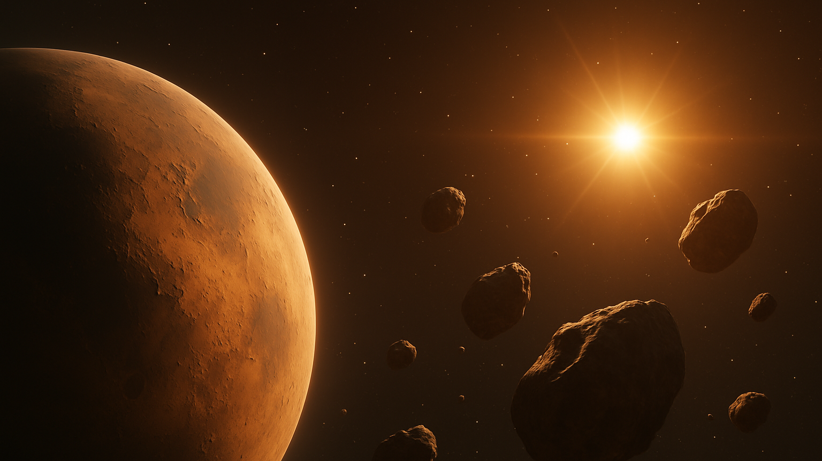
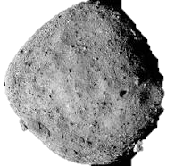
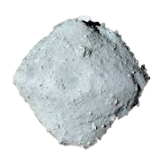
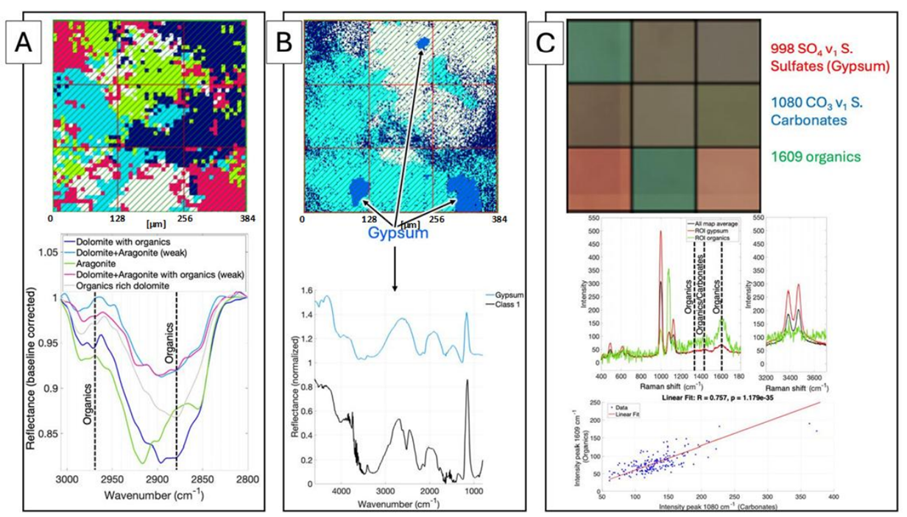


ASTEROID SAMPLE RETURN
NASA OSIRIS-REx mission:
JAXA Hayabusa2 mission:
Collected $∼5$g of regolith from Ryugu
Numerous amino acids
Uracile^{[2]}
${10}^{4}$ organic molecules
Aqueous alteration
Collected $∼120$g of regolith from Bennu
14 of 20 amino acids used in terrestrial biology^{[1]}
All 5 nucleobases
Aqueous alteration
(101955) Bennu
(162173) Ryugu
First time co-located measurements (IR and Raman) on asteroid samples
Organics-minerals correlations
Direct comparison between two asteroid samples
co-located measurements between micro-FTIR and Raman on a natural sample
[4] D.P. Galvin et al. 2025; [5] Y. Oba et al. 2023
Notes:
The second part of my PhD will instead regard asrteroids.
Type C (carbonaceous) asteroids, like Bennu and Ryugu, are very interesting targets for astrobiology, because for instance they can give important inormations about prebiotic chemistry, complex organic delivery and water delivery to planets like Earth.
Next year pristine samples from both OSIRIS-Rex and Hayabusa2 missions will arrive at our laboratory. Both the asteroids investigated with these missions are very interesting, indeed as you can see the NASA mission found on Bennu 14 out of 20 of the amino acid used in terrestrial biology togheter with all 5 nucleobases and traces of water alteration. Jaxa mission on its part found numerous amino acids, 10 to the fouth organic molecules and acqueous alteration.
Here at Arcetri for the first time we will perform co-located Raman and infrared measurments on those asteroid samples, in addition to organic-mineral correlations and mineralogy-grain size correlations studies. Morover we will be able to directly compare the samples.

Slide 5






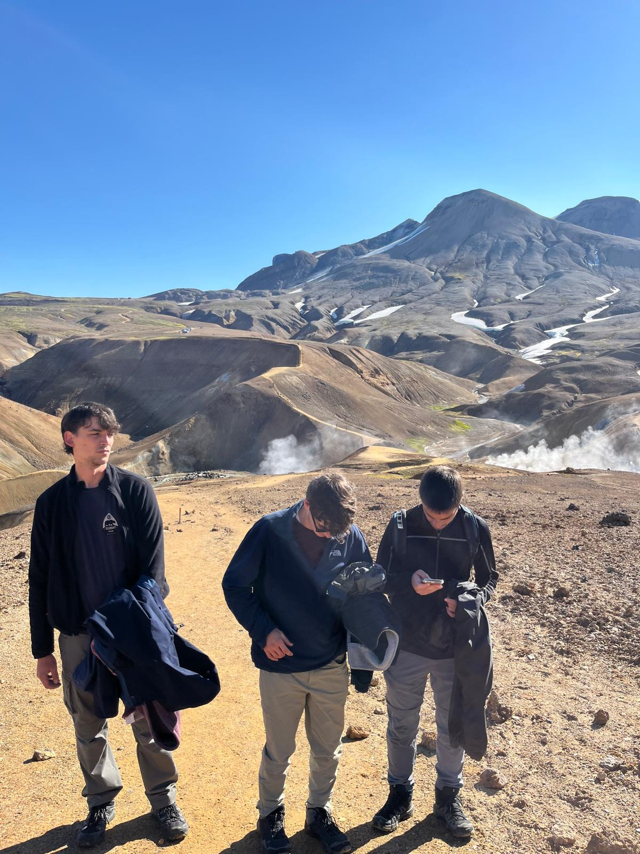


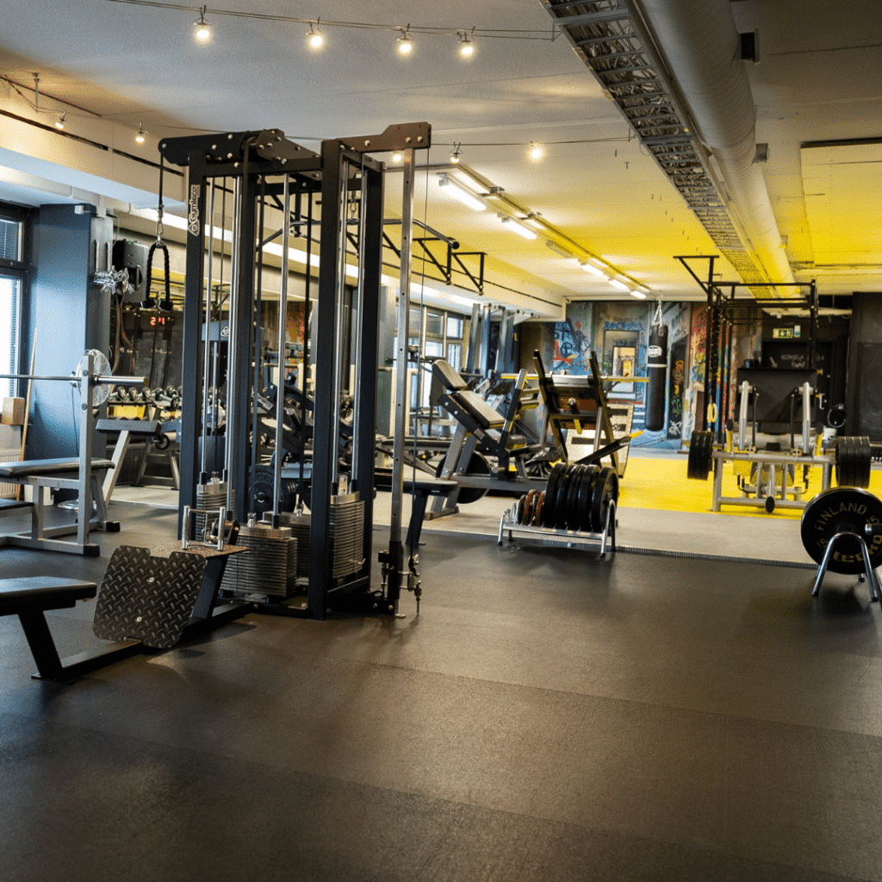

CURATION FACILITY
Prato (FI) will host the first Italian curation facility for extraterrestrial material.
I will:
Develop protocols for manipulation and preliminarly analysis of extraterrestrial material.
Define procedures to guarantee preservation and avoid contamination
HOBBY
Notes:
To conclude, remaining in the field of sample return, the first Italian curation facility for handling extraterrestrial material will be built in Prato. In this context my job will be to manage the initial path of these materials from sample return missions by developing protocols for initial characterization and defining procedures to guarantee preservation

